Slide 1
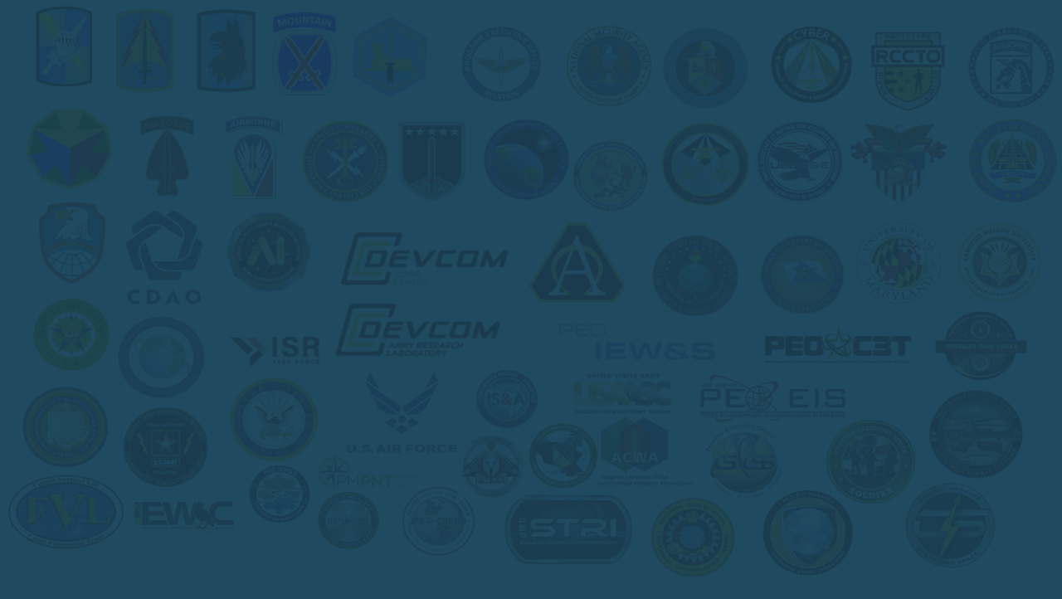
Project Linchpin
Organizational Standup
Governance and Process
AI Policy, Regulations, & Guidance
Program Initiation
DoD / IC Partnerships
Department of Defense / Intelligence Community
FY25 Plan & Purpose PROJECT LINCHPIN ARMY’S FIRST AI FOCUSED PROGRAM OF RECORD!
TORC
Traceability Observability / Orchestration
Replaceability automated Consumption
Pilots and Prototyping
AI Layered Defense Framework
SBIRs
Small Business Innovative Research

