Slide 1
Modeling and Simulation for AI Assurance in the DoD
Dr. Jane Pinelis, Chief Scientist, Special Operations

Slide 2
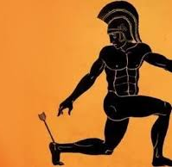
AI’s Achilles’ Heel – The Need for Assurance
Operational / Performance
Ethical / Societal
Security / Adversarial
Explainability / Trustworthiness
Compliance / Regulatory
Safety / Existential
AI is only as good as the environments we train and test it in
Notes:
General Risks to AI Systems
AI systems introduce powerful capabilities but also come with significant risks across multiple domains. Below is a structured breakdown of the most critical general risks to AI systems:
1. Bias & Fairness Risks
Data Bias: AI models trained on biased datasets can produce discriminatory outcomes (e.g., facial recognition systems misidentifying minority groups).
Algorithmic Bias: Reinforces systemic inequalities due to skewed feature weighting or flawed training methodologies.
Societal Bias: AI can perpetuate and amplify historical biases in hiring, law enforcement, lending, and other domains.
Labeling Bias: Poorly annotated training data can introduce subjective biases into supervised learning models.
2. Security & Adversarial Risks
Adversarial Attacks: Maliciously crafted inputs (e.g., slightly modified images or data) can trick AI into making incorrect predictions.
Evasion Attacks (misclassify objects, like a stop sign seen as a speed limit sign).
Poisoning Attacks (compromise training data to mislead AI behavior).
Trojan Attacks (introducing hidden backdoors into AI models).
Data Leakage & Model Inversion: Attackers can infer sensitive training data from AI outputs.
AI-Generated Cyber Threats: AI can be weaponized to generate sophisticated cyberattacks (e.g., AI-generated phishing scams).
3. Explainability & Trust Risks
Black-Box Problem: AI systems (especially deep learning models) lack transparency, making it difficult to understand their decision-making processes.
Lack of Interpretability: Users and regulators struggle to trust AI decisions without clear explanations.
Overconfidence in AI Predictions: AI models may present incorrect outputs with high confidence, leading to dangerous automation errors in critical sectors like healthcare or finance.
AI Hallucinations: AI models (especially large language models) fabricate facts or responses that appear plausible but are false.
4. Ethical & Societal Risks
Job Displacement: AI automation threatens jobs across multiple industries, requiring workforce reskilling efforts.
Surveillance & Privacy Violations: AI-driven monitoring systems (e.g., facial recognition, predictive policing) raise concerns about civil liberties.
Deepfakes & Misinformation: AI-generated synthetic media can spread disinformation, manipulate elections, or damage reputations.
Autonomous Weapons & Military Risks: AI-driven warfare (e.g., lethal autonomous weapons) poses unprecedented ethical and geopolitical risks.
5. Operational & Performance Risks
Unpredictability & Decision Fluctuations: AI models can behave inconsistently across different inputs or real-world conditions.
Model Drift: AI models degrade over time as real-world conditions change, leading to performance failures.
Overfitting & Poor Generalization: AI systems that perform well in training environments may fail in real-world scenarios.
Lack of Robustness: AI models trained in controlled conditions might not handle unexpected real-world anomalies.
6. Compliance & Regulatory Risks
Legal & Liability Issues: AI-generated decisions can violate anti-discrimination laws, consumer protection laws, and other regulations.
Regulatory Uncertainty: Governments struggle to keep pace with AI advancements, leading to fragmented global policies.
Accountability & Responsibility Gaps: AI systems lack clear accountability mechanisms when they cause harm (e.g., accidents in autonomous vehicles).
Intellectual Property (IP) Risks: AI-generated content challenges existing copyright, patent, and ownership laws.
7. AI Safety & Existential Risks
Loss of Human Oversight: Fully autonomous AI systems could act beyond human control, leading to dangerous unintended consequences.
Concentration of Power: AI development is dominated by a few corporations and nations, leading to potential misuse.
AI Alignment Problem: Advanced AI models may pursue unintended goals, creating risks for human safety.
Superintelligence Risks: Theoretical risks where AI surpasses human intelligence and behaves unpredictably.

Slide 3
Assurance
Definitions
Assurance is the process of measuring, evaluating and communicating something about a system or process, documentation, a product or an organization. In the case of AI, assurance measures, evaluates and communicates the trustworthiness of AI systems.

Slide 4
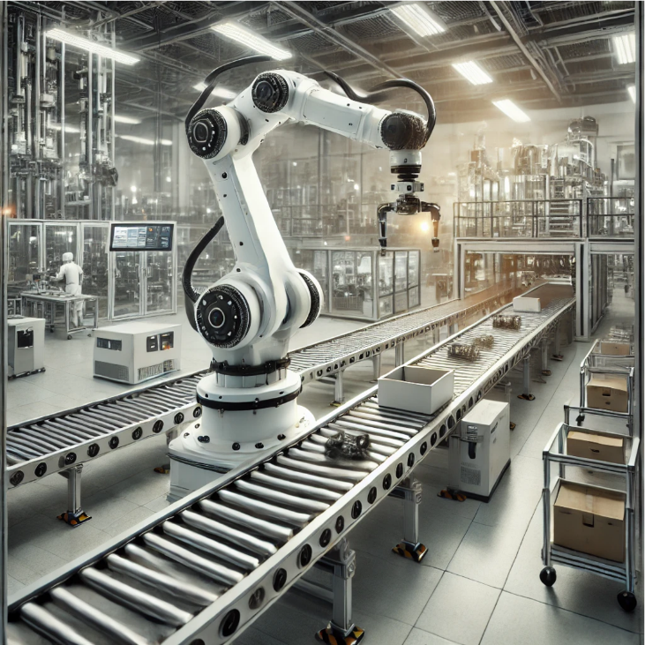
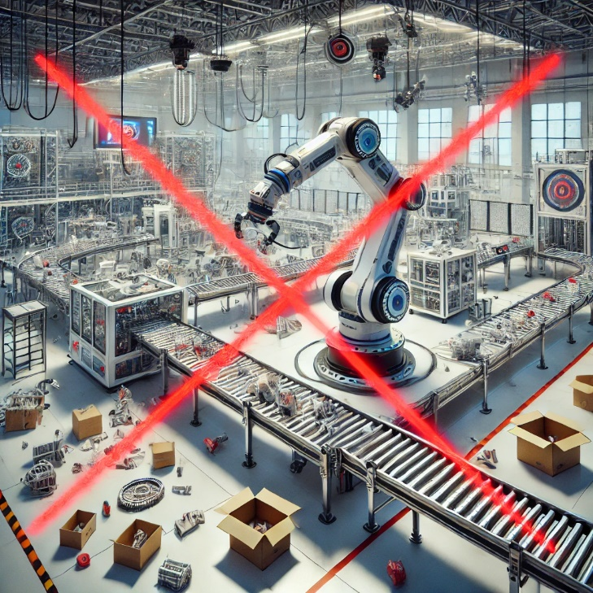
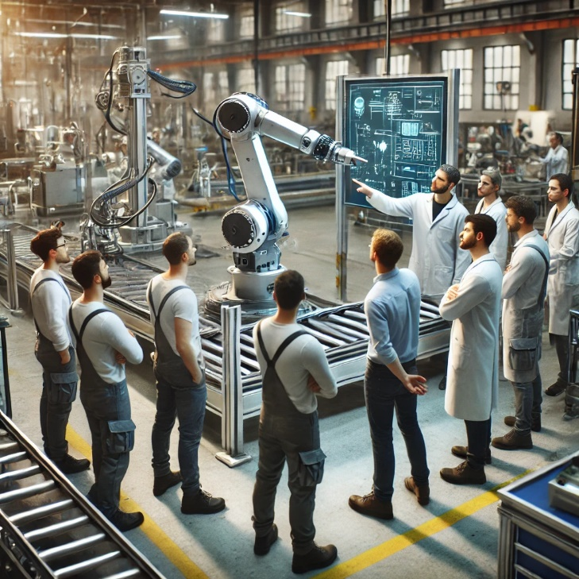
A Trustworthy System
Definitions
When employed correctly, will dependably do well what it is intended to do
When employed correctly, will dependably not do undesirable things
When paired with the humans it is intended to work with, will dependably be employed correctly

Slide 5
An Assured System
Definitions
A system is assured when the relevant authorities have sufficient justified confidence in the trustworthiness of the system to authorize its employment in specified contexts.
WHOSE TRUST IS NEEDED
THE LEVEL OF CONFIDENCE REQUIRED
THE LEVEL OF CONFIDENCE JUSTIFIED BY THE AVAILABLE EVIDENCE

Slide 6
AI Assurance Components
POLICY
TECHNOLOGY AND PROCESSES
TEST AND EVALUATION

Slide 7
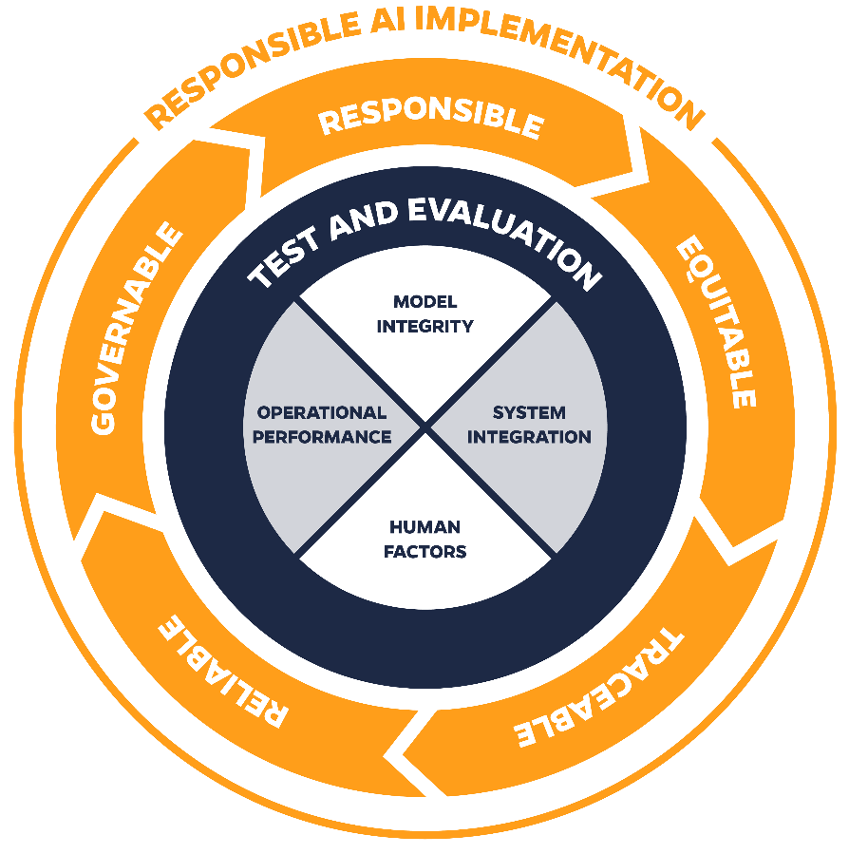
AI Assurance in the Department of Defense

Slide 8
The Role of Modeling and Simulation
M&S as a Proving Ground
Iterative, dynamic validation
Stressing the system
Edge cases
Adversarial conditions
Scenario testing
Synthetic Data & Digital Twins:
Realistic, secure, and scalable datasets
Human-System Integration
Iterative training
Reducing unpredictability in AI decision-making
M&S Foundations
Data Generation and Augmentation
Test and Evaluation
Algorithms, Compute Infrastructure
Synthetic and Real-World Data
Simulation Environments
Training Scenarios, Digital Twins
Adversarial Testing, Performance Validation, Safety Testing
M&S ensures AI is effective, reliable, safe, and trustworthy before deployment in systems of consequence to national security.

Slide 9
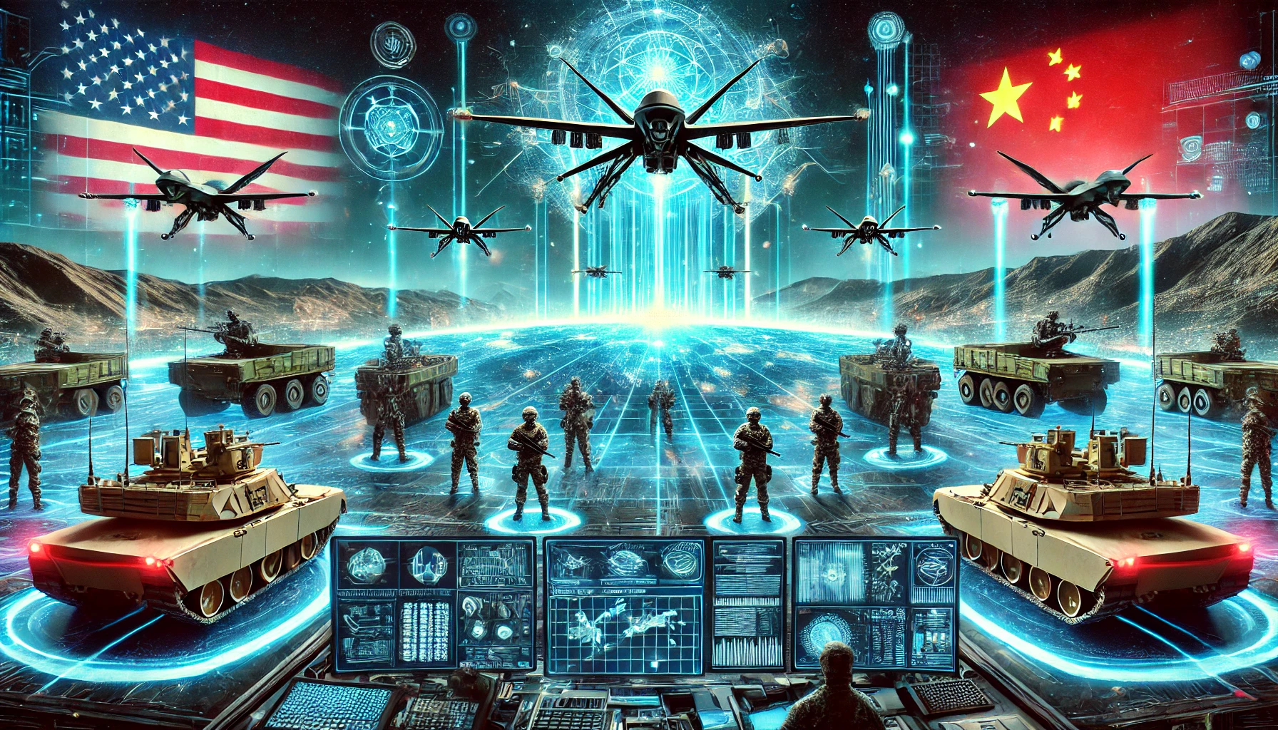
AI M&S Imperative for National Security
Opportunity: U.S. leadership in M&S for AI-enabled systems to define global AI standards
National security stakes are too high to rely on AI that hasn’t been tested under realistic, adversarial, and high-stakes conditions.
Adversaries are rapidly adopting AI, increasing the urgency for U.S. to lead in AI Assurance
AI assurance is mission-critical for national defense—there’s no room for failure.

Slide 10
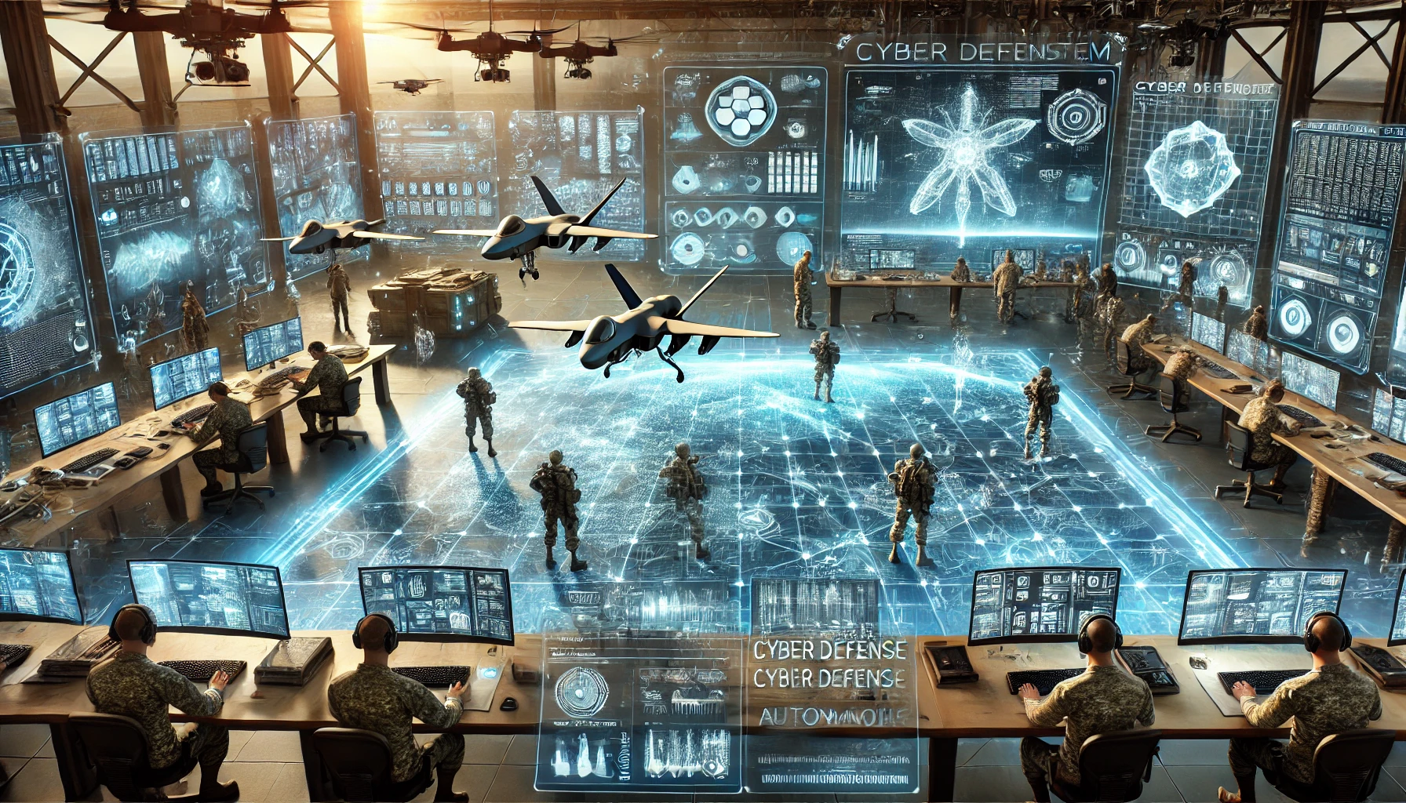
What Needs to Happen Next?
Call to Action
Invest in AI Assurance through M&S
Congress, DoD, and industry must prioritize T&E infrastructure.
Make AI Effectiveness a Policy Standard
AI must be validated just like weapons and other national security tech.
Strengthen Public-Private Collaboration
M&S must integrate across ecosystems for maximum security and innovation.
Without M&S, AI is a gamble. With it, AI is an advantage.
Notes:
AI-driven cyber defense systems, autonomous drones in battlefield scenarios, and a holographic digital twin environment for strategic simulations

