Slide 1

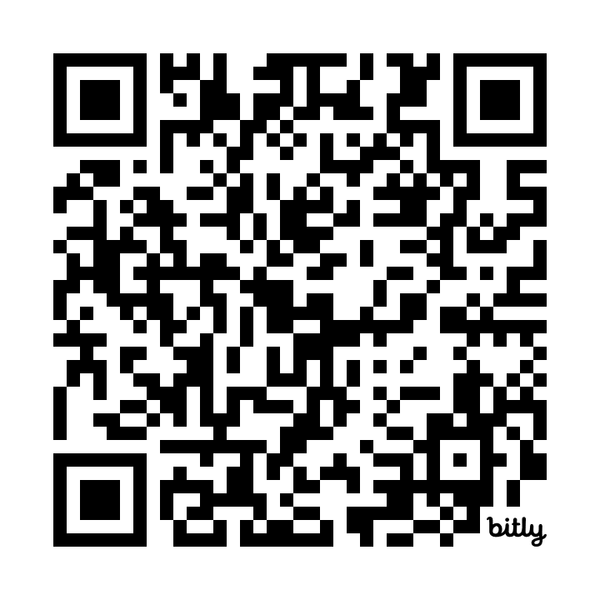
https://bit.ly/chatgptassignments
Notes:
Kevin

Slide 2
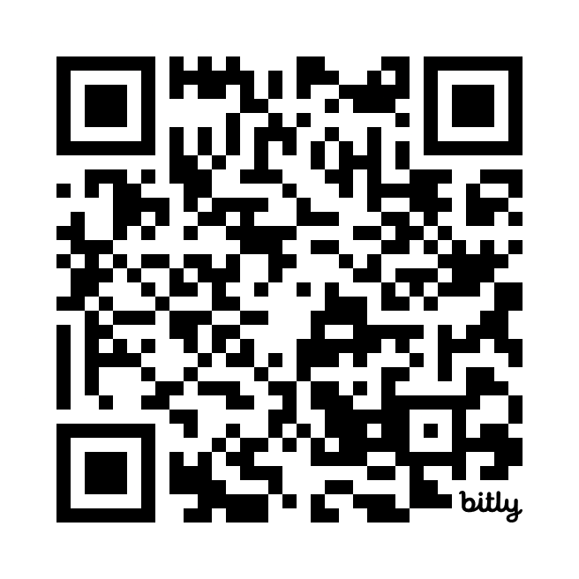

https://bit.ly/AI-hacks

