Slide 1
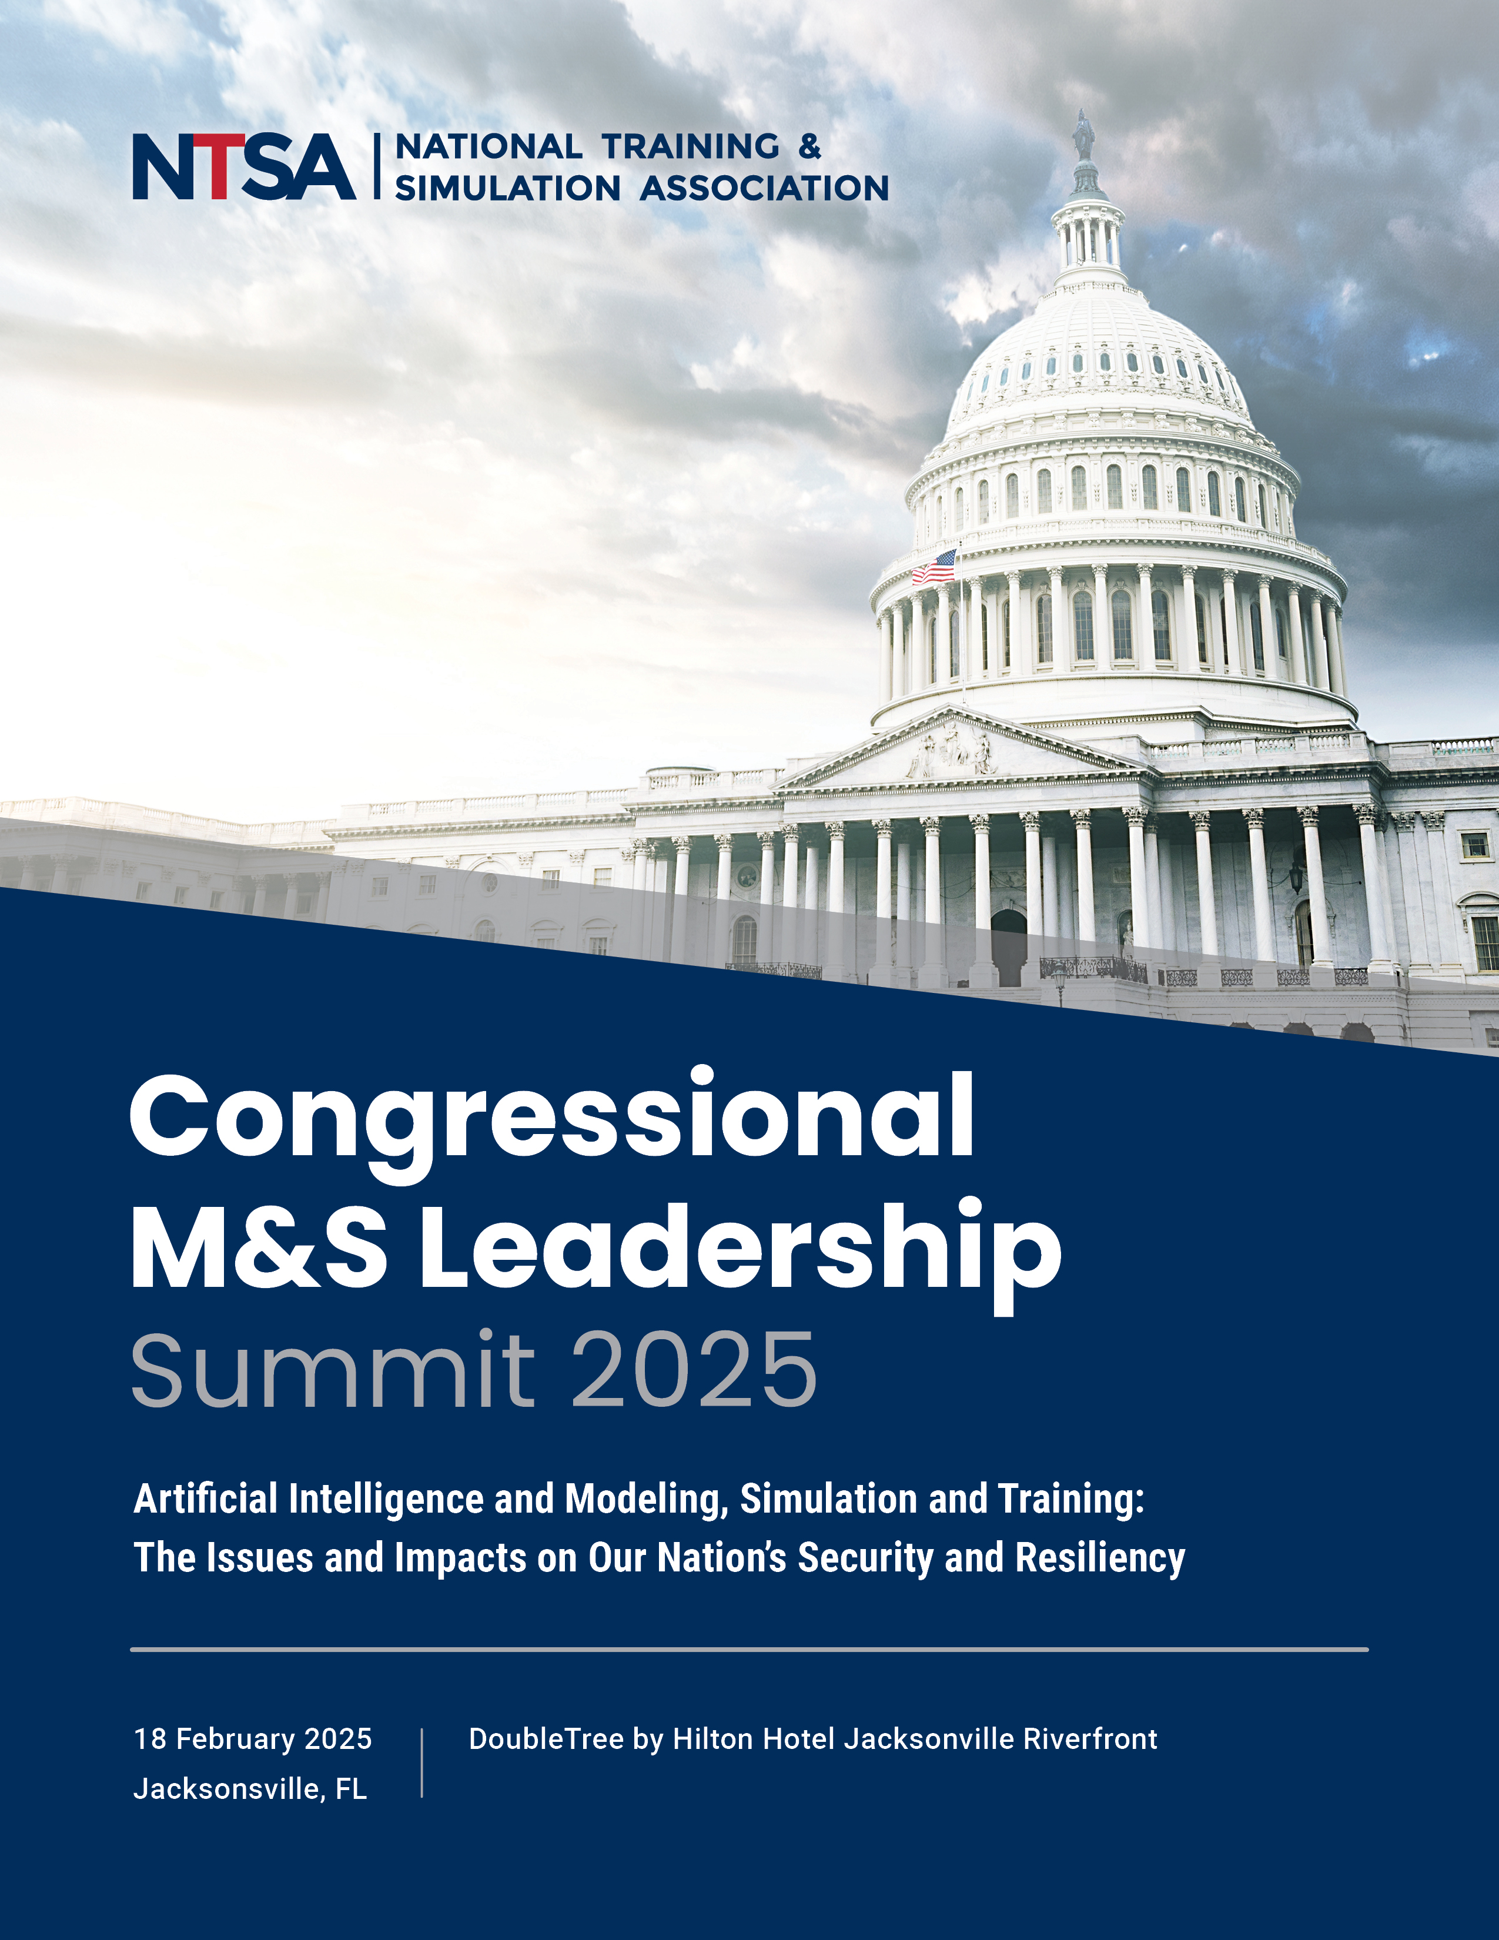
Bob Kleinhample, CMSP, President, PioneerSim, Moderator Paul Graham, Ph.D., Director of Applied Innovations, DEVCOM SC UARC (ICT) Brian Stensrud, Ph.D., Technical Fellow, Artificial Intelligence, CAE USA
State of AI in the MS&T Industry

Slide 2
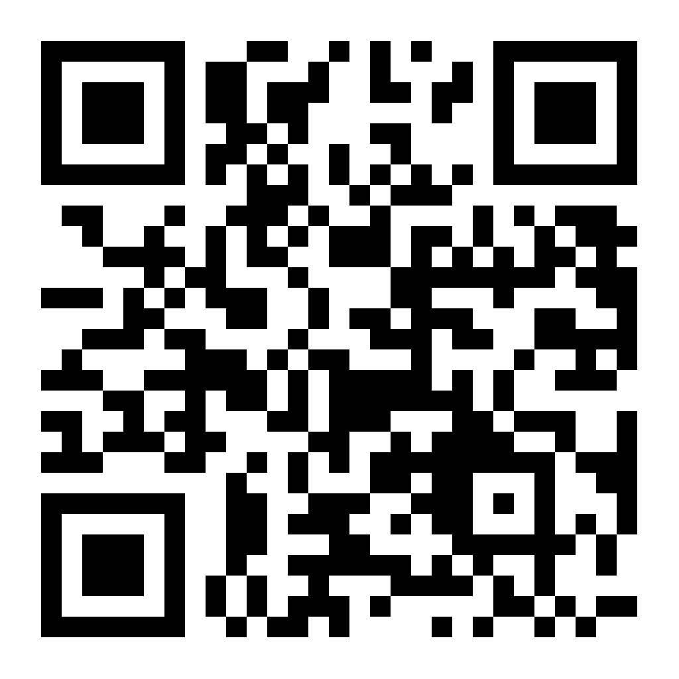
Executive Order on AI Removing Barriers to American Leadership in Artificial Intelligence
Purpose.
The U.S. has long been at the forefront of AI driven by
Strength of our free markets
World-class research institutions
Entrepreneurial spirit
To maintain the leadership, we must -
Develop AI systems free from ideological bias or engineered social agendas
With the right government policies –
We can solidify our position as the global leader in AI
Policy. Sustain and enhance America’s global AI dominance in order to promote
Human flourishing
Economic competitiveness
National Security
Develop an Artificial Intelligence Action Plan within 180 days.
Assistant to the President for Science and Technology (APST)
Special Advisor for AI and Crypto
Assistant to the President for National Security Affairs (APNSA)
ICW Assistant to the President for Economic Policy, the Assistant to the President for Domestic Policy, The OMB Director, and heads of executive departments and agencies the APST and APNSA deem relevant.

Slide 3
Brian Stensrud, Ph.D., Technical Fellow, Artificial Intelligence, CAE USA
State of AI in the MS&T Industry
Industry Perspective

Slide 4
Survey Insights
Usage of GenAI services (ChatGPT, Gemini, Copilot) is prevalent in our industry
Most respondents reported on-the-job usage (surprising to me!) – most for system development
A *significant* majority reported at-home usage
Many users have directly observed ‘suboptimal’ outputs from LLM systems
Hallucinations (~70%), Inherent bias (~55%)
0 observations of threatening, dangerous responses (e.g. suggesting physical harm)
Most organizations have at least some level of restrictions in place
Close to half of respondents report observed violations of their policy
Enforcement is difficult, even with blocked-access policies
Concerns about merits, drawbacks of AI policy
Over-regulation stifling innovation, preventing production
Policies in place based on a lack of understanding, with lack of contribution from technical stakeholders

Slide 5
Paul Graham, Ph.D., Director of Applied Innovations, DEVCOM SC UARC (ICT)
State of AI in the MS&T Industry
Government Perspective

Slide 6
AI Policy in one word
Encourage

Slide 7
How?
Encourage
Secure
Educate
Monitor

Slide 8
What Can We Affect?
ID challenges for industry working with government
Laws
Boundaries
Opportunities for authorization language. Make it easier for us to support national security
Consistencies/Common Rules
ID what is useful
ID priorities

