Slide 1
TRAINING & SIMULATION INDUSTRY SYMPOSIUM
COL MARCUS J. REYNOLDS

Slide 3
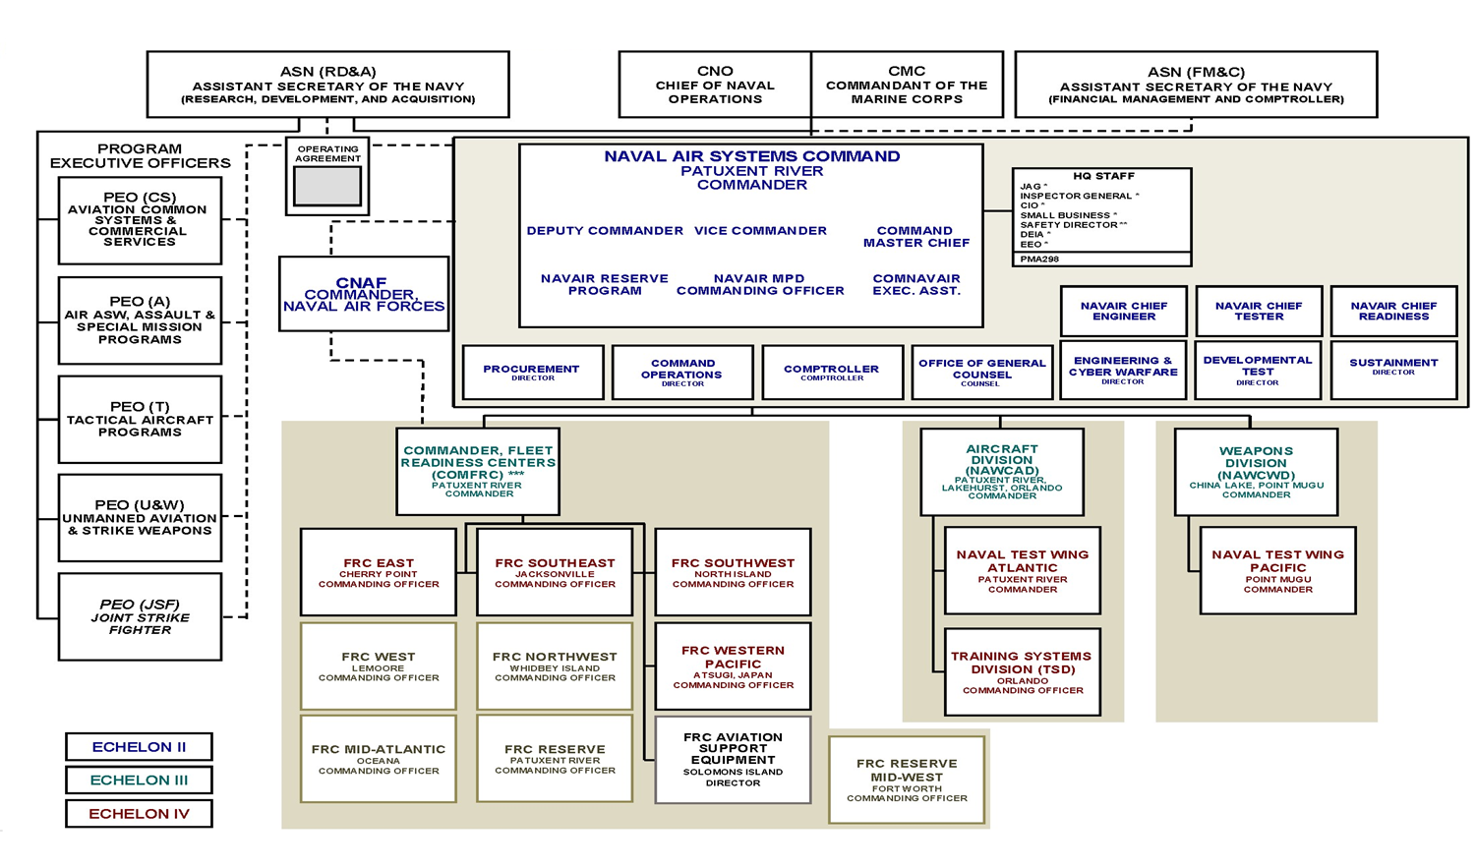

Slide 5
PROGRAM MANAGER’S MISSION
Rapidly Field Training Systems to the Warfighter in support of Force Design.
138 Marines, Civilians & Contractors
Located in 5 States; Japan & Guam
~ $368.5 Annually ($1.9B FYDP FY24-28)
(FY 24)RDT&E $26.1M; PMC $88.9M;
OMMC $5.2M; OCF $248.3M
ACAT | Pre-MDD | Post-MDD | EMD | P&D | O&S | TOTAL
IV | 0 | 0 | 1 | 5* | 0 | 6
AAP +Other Pre JCIDS | 0 | 2 | 1 | 3 | 12 | 19
TOTAL | 0 | 2 | 2 | 8 | 12 | 24
Portfolio CLS Efforts* –
GTSS East (~$40M), GTSS West (~$22M), GTSS CONUS, GTSS OCONUS (~$15M), RP/IIT SME Consolidation (~$14M), MTSS (~$245M), PDSC (~$44M), ECS (~$238M), ERS-S (~$249M)
* Amounts represented are total contract value
9

Slide 7
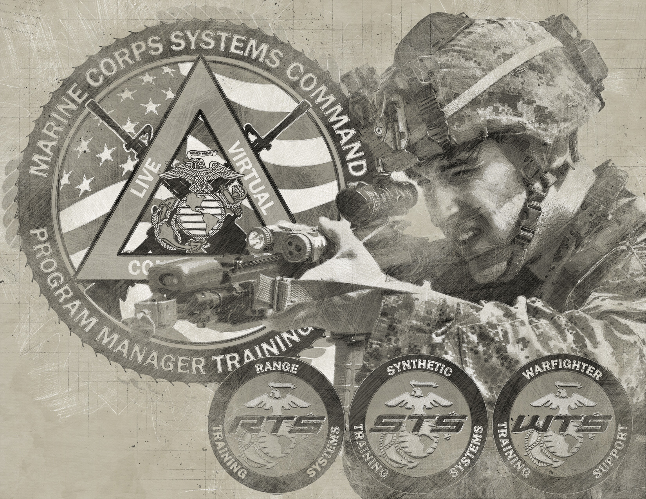

Slide 8
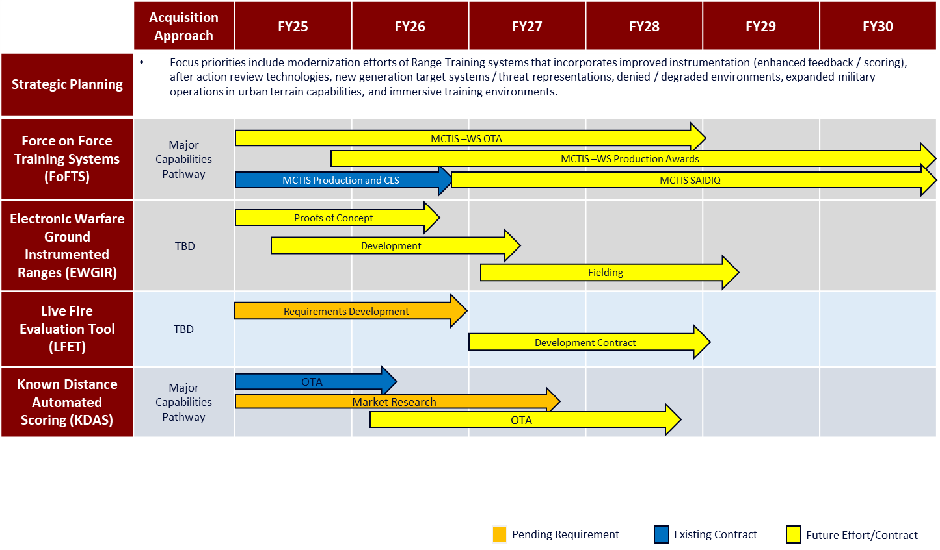

Slide 10
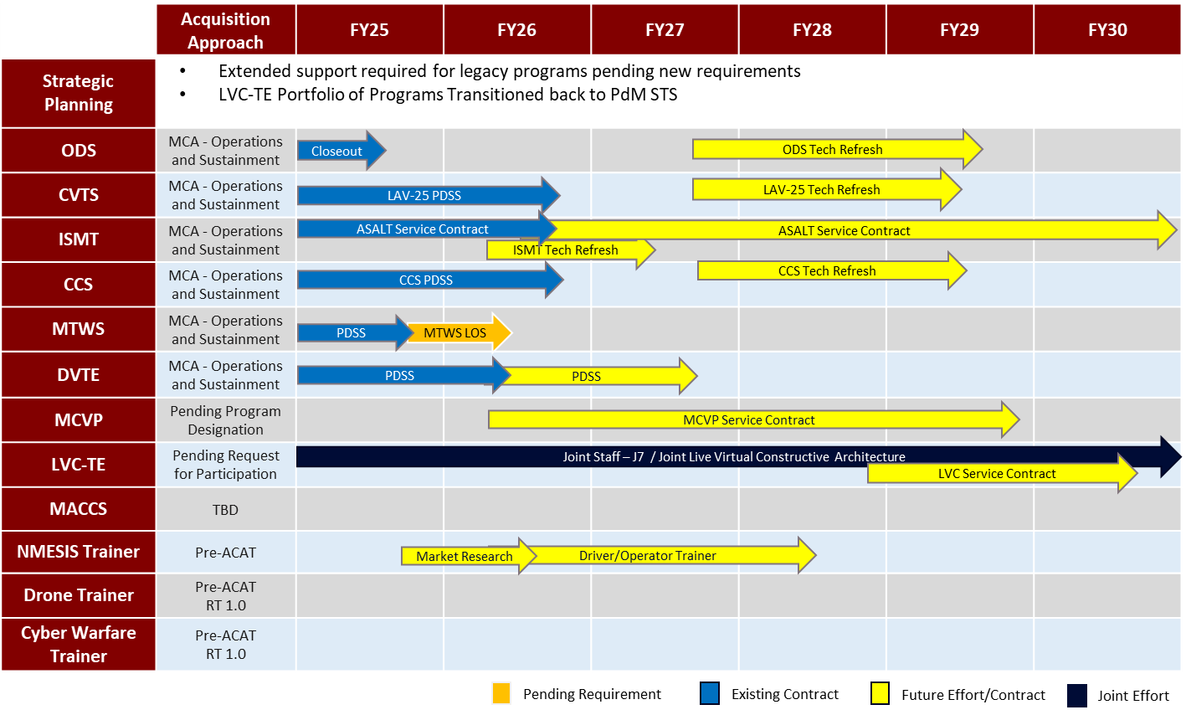

Slide 12
