Slide 1
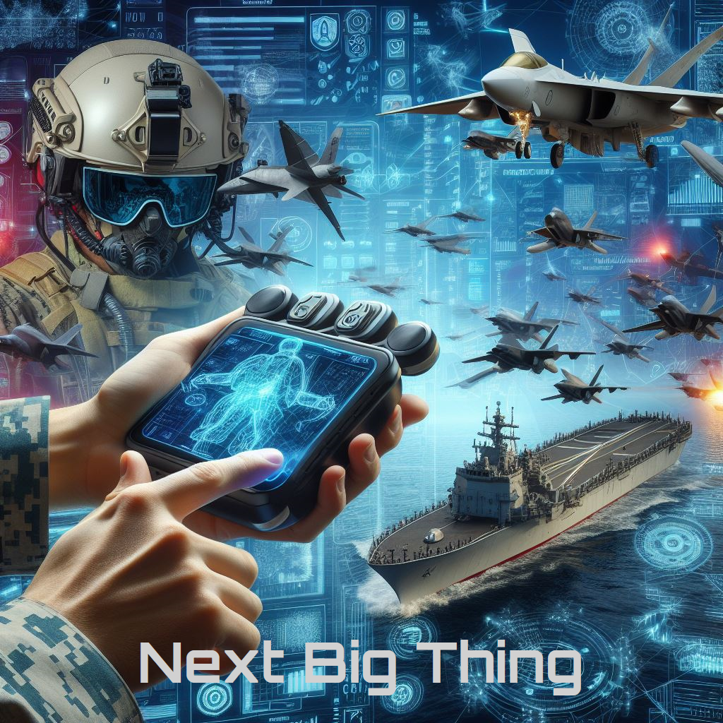
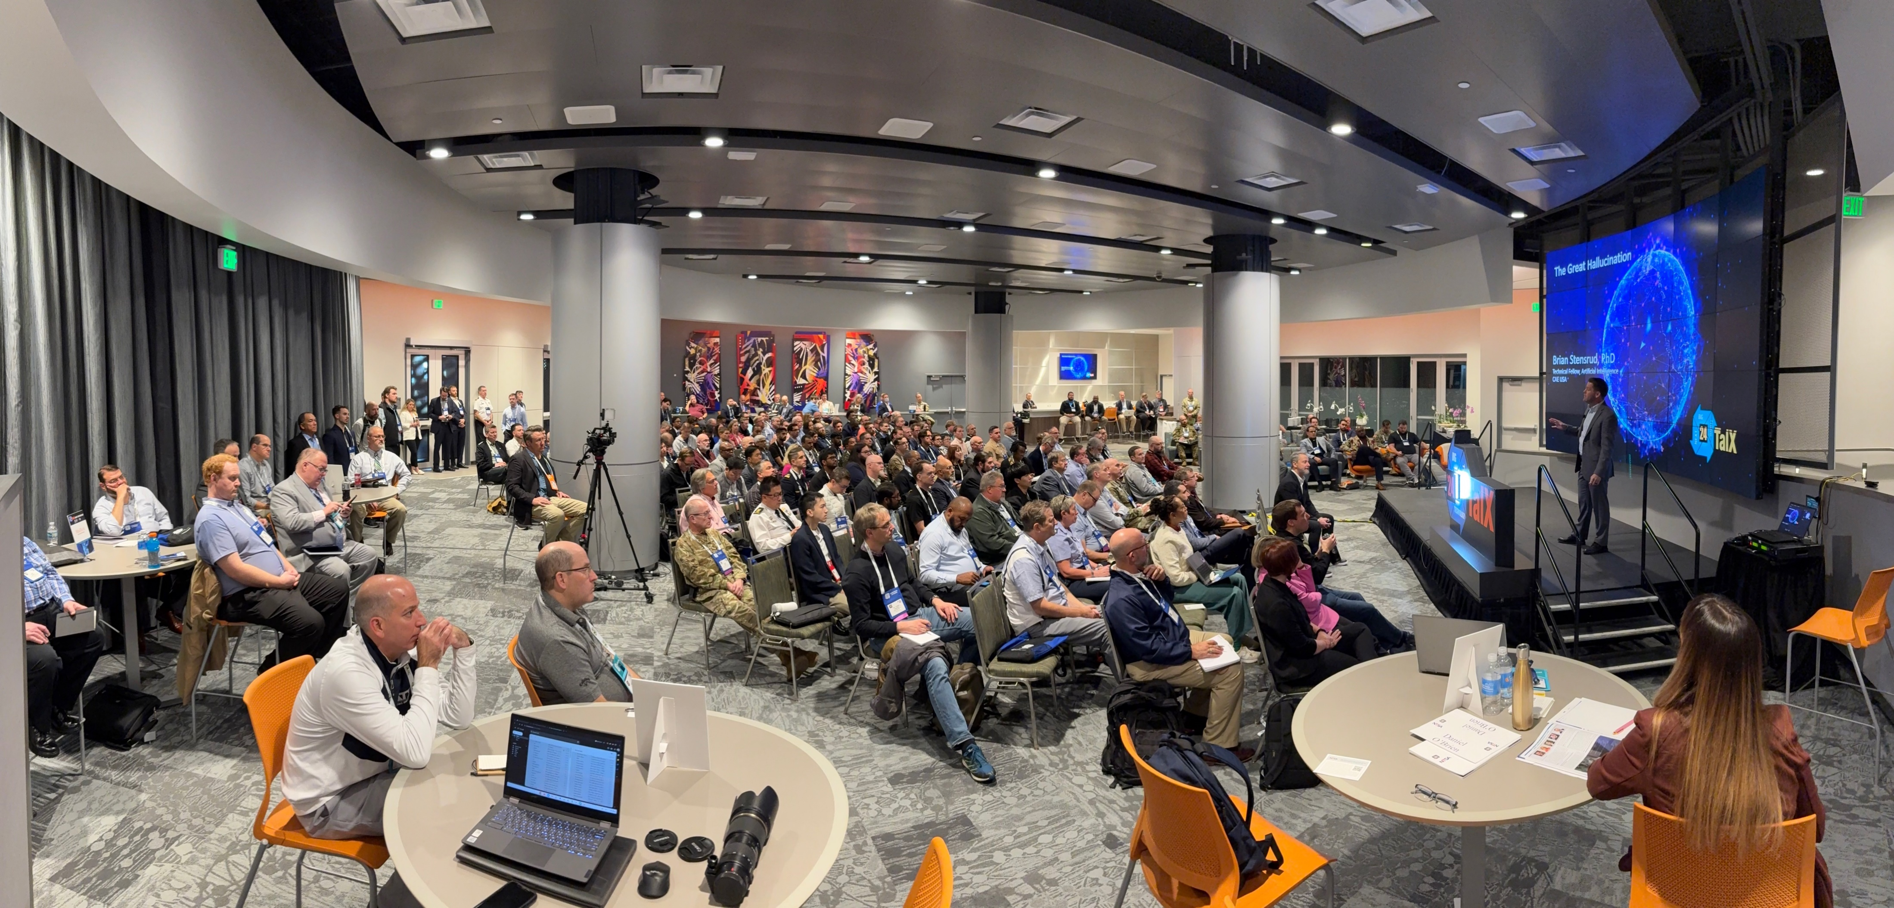
NTSA Next Big Thing 2025
Mission: Accelerate the adoption of emerging technologies in MS&T
Moderator: Mr. Bob Kleinhample
CEO PioneerSim Inc
Our Journey
Market Insights
Dr. Brian Stensrud
Technical Fellow, CAE USA
Ms. Sam Burns
Dir., Oliver Wyman Aerospace, Defense, & Government
Notes:
Why: Position your organizations and companies adopt these technologies
Brian will discuss our Journey, last year and and where we are gong this year. You will better understand how your organizations can get involved this year.
We will reflect on what we did last year culminating at I/ITSEC and provide you information about our call for presentations for this year’s I/ITSEC.
Sam will give you market insights which you can use position your organizations. I reflect back on strategic growth plan of several organizations I’ve been involved with . An understanding of the market is essential be it
You want to position to be acquired
You want to position to have game changing and responsive solutions to emerging warfighter needs
What does the landscape look like?
Who are the players and what are they offering?
How do you differentiate?
To prime the pump, I’ll share some of my perspectives.
AI. Developers and the integrators.
XR
Edge. Where and when needed
Cognitive Solutions. Make better and more informed decisions in a complex world.
Needs: You are going to hear about these from the respective services. Challenge them to describe their operational needs (vice ask for the specific technical solution). That is what industry does well.
Make use of these breaks to discuss what each of you have to offer. Form those partnerships. Bring solutions (A good understanding of the problem and need, and how your capability meets that need)

Slide 2
NTSA Next Big Thing 2025
Our Journey
Dr. Brian Stensrud
Technical Fellow, CAE USA
Notes:
Why: Position your organizations and companies adopt these technologies
Brian will discuss our Journey, last year and and where we are gong this year. You will better understand how your organizations can get involved this year.
We will reflect on what we did last year culminating at I/ITSEC and provide you information about our call for presentations for this year’s I/ITSEC.
Sam will give you market insights which you can use position your organizations. I reflect back on strategic growth plan of several organizations I’ve been involved with . An understanding of the market is essential be it
You want to position to be acquired
You want to position to have game changing and responsive solutions to emerging warfighter needs
What does the landscape look like?
Who are the players and what are they offering?
How do you differentiate?
To prime the pump, I’ll share some of my perspectives.
AI. Developers and the integrators.
XR
Edge. Where and when needed
Cognitive Solutions. Make better and more informed decisions in a complex world.
Needs: You are going to hear about these from the respective services. Challenge them to describe their operational needs (vice ask for the specific technical solution). That is what industry does well.
Make use of these breaks to discuss what each of you have to offer. Form those partnerships. Bring solutions (A good understanding of the problem and need, and how your capability meets that need)

Slide 3
What is the Next Big Thing?
NBT is a showcase of novel and nascent technologies poised to disrupt the industry within the next 3-5 years
Why? Raise awareness, accelerate the maturation and adoption of these technologies
How? NTSA events sponsored throughout the year
Culmination at I/ITSEC
Next: not now! 3-5 year time horizon
if there’s a demo, it’s not next!
Big: disruptive, industry-changing
Thing: technology, application, event

Slide 4
2024 Themes
Novel applications of data
Large Language Models
Human Machine Teaming
Next-gen XR, HCI
Lessons from Ukraine
Catalysts to Adoption
Government Innovation Labs

Slide 5
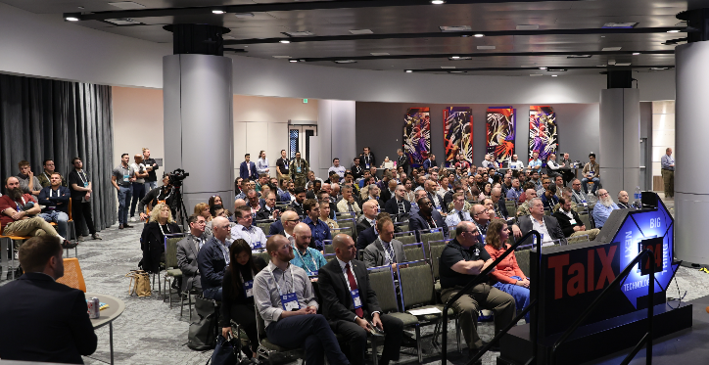
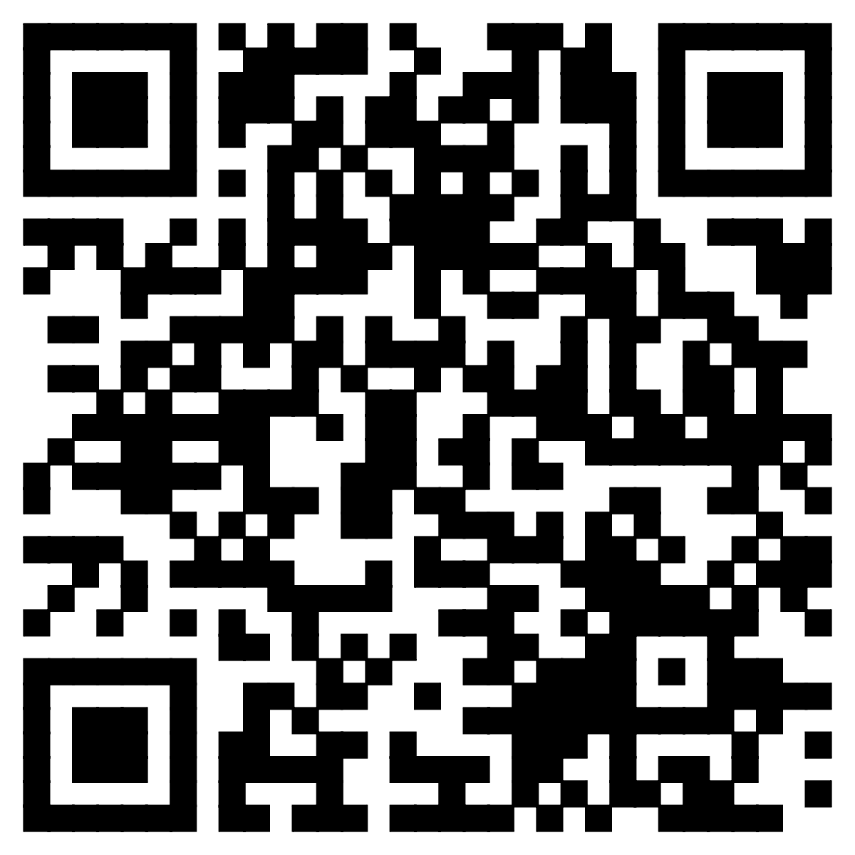
2025 – Anticipated Themes
LLM 2.0: what’s the next AI disruptor?
Quantum Computing
Spatial Computing and Rendering
The coming cyber conflict
New perspectives on facilitating adoption
The future acquisition environment
… and your submission!

Slide 6
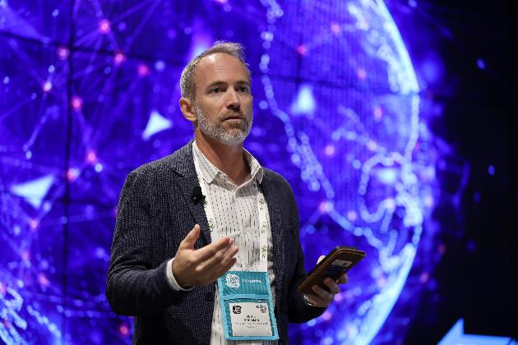
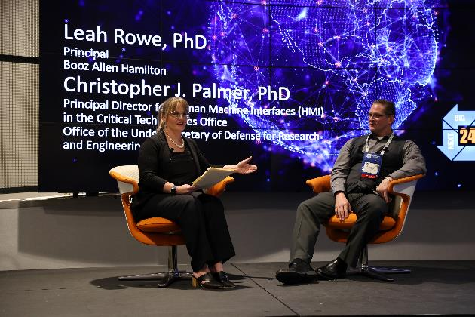
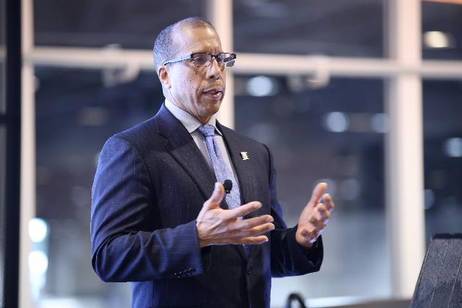
Formats
20min TED-style talks (no slides, just discussion!)
Collaborative discussions
Town hall discussions with audience participation
Notes:
TED talks: clean YouTube-ready presentations. Challenge conventional wisdom! Inspire! Motivate!
Collaborative discussion: TARGET: government and stakeholder perspectives on industry need

Slide 7
NTSA Next Big Thing 2025
The MS&T Market
Ms. Sam Burns
Director, Oliver Wyman Aerospace, Defense & Government Practice
Notes:
Why: Position your organizations and companies adopt these technologies
Brian will discuss our Journey, last year and and where we are gong this year. You will better understand how your organizations can get involved this year.
We will reflect on what we did last year culminating at I/ITSEC and provide you information about our call for presentations for this year’s I/ITSEC.
Sam will give you market insights which you can use position your organizations. I reflect back on strategic growth plan of several organizations I’ve been involved with . An understanding of the market is essential be it
You want to position to be acquired
You want to position to have game changing and responsive solutions to emerging warfighter needs
What does the landscape look like?
Who are the players and what are they offering?
How do you differentiate?
To prime the pump, I’ll share some of my perspectives.
AI. Developers and the integrators.
XR
Edge. Where and when needed
Cognitive Solutions. Make better and more informed decisions in a complex world.
Needs: You are going to hear about these from the respective services. Challenge them to describe their operational needs (vice ask for the specific technical solution). That is what industry does well.
Make use of these breaks to discuss what each of you have to offer. Form those partnerships. Bring solutions (A good understanding of the problem and need, and how your capability meets that need)

Slide 8
Training and Simulation: Key Segments and Market Shifts
Education
Live-Virtual-Constructive Training
Mission Planning and Wargaming
Testing and Experimentation
Digital Engineering
MS&T serving a critical role of enabling and informing future CONOPS
MS&T aligned to multiple disruptive tech vectors over next 5-10+ years
1
2
Shifts in MS&T (and broader DoD) buying behavior are accelerating
3

Slide 9
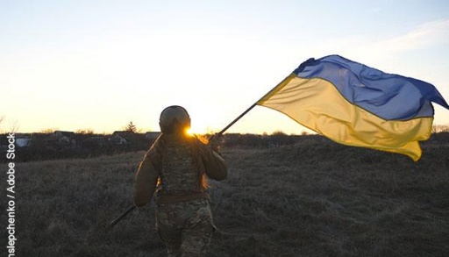
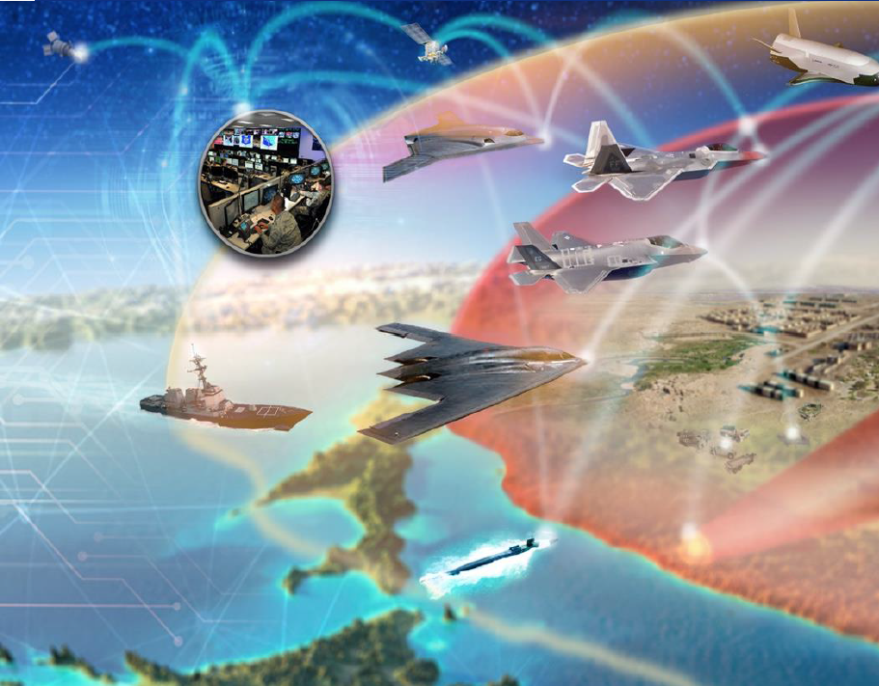
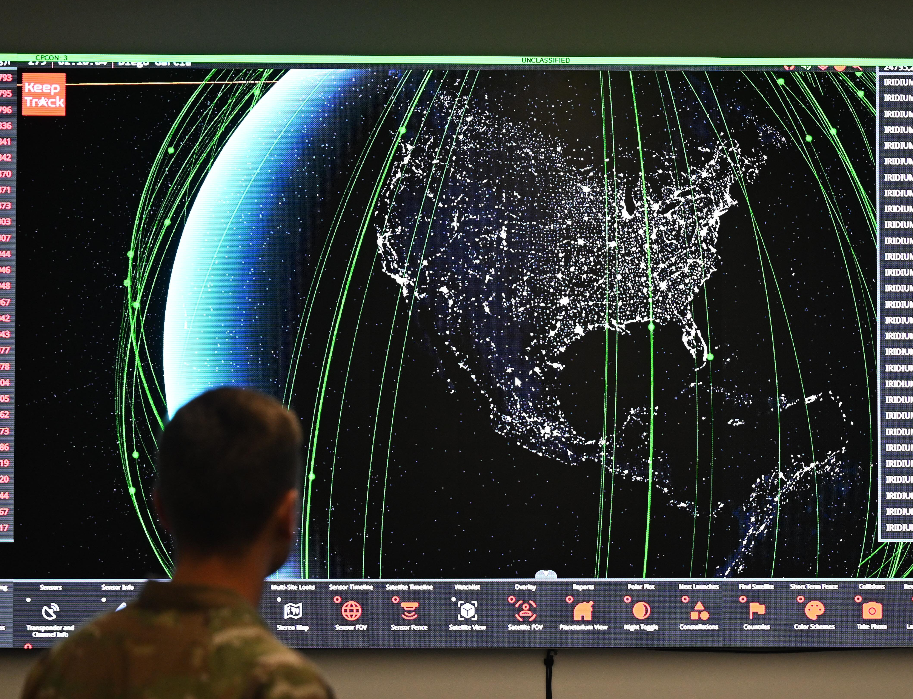
Emerging CONOPS will be Enabled and Informed by MS&T
Training and Simulation enabling FY2026+ Priorities
Combined & Joint Operations
Interoperable, multi-level, and secure Live-virtual-constructive (LVC) environments underpin DoD efforts to advance fully integrated all-domain operations across joint and coalition partners
Accelerated AI adoption
DoD is investing heavily in AI to accelerate kill chain operations, unlocking advanced simulation capabilities such as rapid analysis of vast sensor data, course of action (COA) generation, and interactive wargaming
Emerging Mission Needs
Mission engineering and simulation are playing an integral role in maturing capabilities across growing DoD priorities in non-kinetic effects, autonomy and collaborative combat, space warfighting, contested logistics, and more
Image Source: AF.mil, DIU.mil, BreakingDefense.com

Slide 10
Buying Behavior Shifts Are Accelerating
Convergence of MS&T Capabilities
Evolving Go-To-Market Levers
Software Acquisition Pathways
Planning
OTA and CSO
Digital Engineering
“Everything as a Service”
LVC
Commercial-Enabled Teams
DoD seeking to break down silos across M&S / digital engineering communities and tools (spanning analysis, acquisition, test, training, etc.) to increase speed, agility, and coordination of efforts

Slide 11
Exposed to Multiple Disruptive Technology Vectors
Education
Live-Virtual-Constructive Training
Mission Planning and Wargaming
Testing and Experiment
Digital Engineering
Key Technology Vectors (Not Exhaustive)
AI and Autonomy
Advanced Microelectronics and Computing
Human – Machine Interfaces
Secure Communications & Networking
Sensing

