Slide 1
Enterprise Digital Learning Modernization
and the DoD Learning Enclave
Advanced Distributed Learning (ADL) Initiative 18 June 2025
Overview of ADL Lines of Effort for the
2025 Training & Simulation Industry Symposium

Slide 2
Disclaimers
ADL is moving to the Defense Manpower Data Center (DMDC)
I am a SETA Contractor and don’t speak for the Government
While these slides have been previously approved, things could change as we become more integrated into DMDC

Slide 3
Enterprise Digital Learning Modernization (EDLM)
Vision
Guide the innovative use of learner data to drive DoD personnel optimization.
Mission
Enhance the quality, quantity and accessibility of learner data to increase DoD effectiveness.
Purpose
Deliver a competitive advantage to upskill our DoD personnel to outpace our adversaries.
Modernization: collect requirements for what data to collect and how to share data DoD-wide via the EDLM program and the DoD Learning Enclave
Governance and Documentation: Policy, specs, standards, acquisition guidance for learning tools, technologies, and platforms that promote learner data interoperability.
Coordination and Integration/Transition: DADLAC (vote on requirements), ESC (recommend COAs for service instantiation)
The ADL Initiative stewards DoDI 1322.26 that guides the tracking, management, and governance of Learning data throughout an individual’s lifetime to improve how DoD understand its personnel skills.
3
Notes:
This is where the assisted acquisition is undertaken – a DoD organization can host systems inside the DLE, the shared IT services.
Part of the learning ecosystem is interoperable learning content. That's where we want people to connect to our systems even if they're not deploying it using our shared services - that's that data strategy. Those are the enterprise data services to be able to collect and interpret all the data from any connected system.
.
Enterprise Digital Learning Modernization
DoD-wide initiative directed by the Pentagon in 2018
Building a data-centric career-long continuum of learning (“learning ecosystem”)
Shared Services Technology stack is named the “DoD Learning Enclave” (DLE)
DLE is launching in FY23 on USAF Platform One
Overseen by Executive Steering Committee (6 Pentagon SESs)
Close collaboration with DoD IC throughout development process
Coordination with CDAO: “pathfinder for enterprise data services”

Slide 4
ADL Authorities
SECDEF Secretary of Defense
USD(P&R) Under Secretary for Personnel & Readiness
DHRA Defense Human Resources Activity
DMDC Defense Manpower Data Center
ADL Advanced Distributed Learning (ADL)

Slide 5
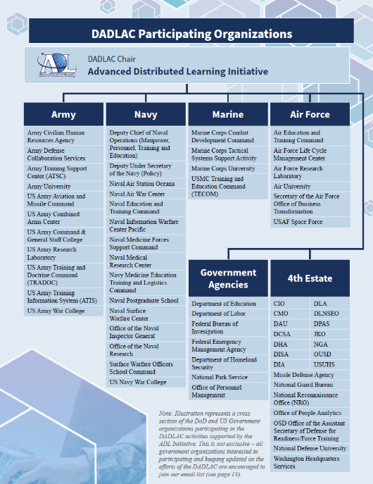
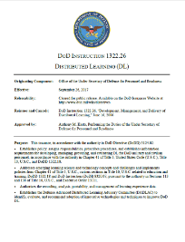
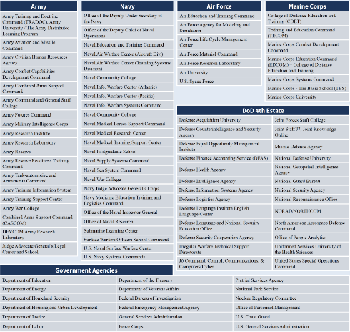
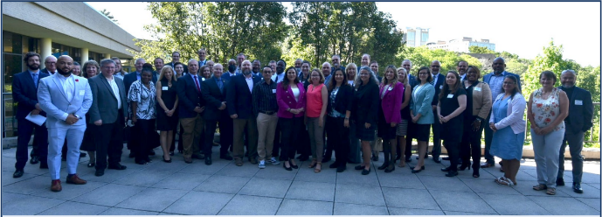
What does ADL bring to the DoD?
Defense ADL Advisory Committee
The DADLAC is granted authorities, responsibilities, and a charter in DoDI 1322.26
Over 95 organizations providing requirements for data interoperability
Operational integration and testing with Army, Navy, and Air Force
Governance structure
5

Slide 6
Enterprise Digital Learning Modernization (EDLM)
DoD Learning Enclave
WHAT?
DoD-wide program directed by the Pentagon in 2018
EDLM Portal (Multi-Tenant)
WHO?
EDLM is a program overseen by an Executive Steering Committee. The program is executed by the ADL Initiative
Learning Management System
Enterprise Course Catalog
Enterprise Competency / Credential Registry
Enterprise Learner Record Repository
WHY?
The EDLM program establishes an interoperable learning ecosystem through the development of an assisted acquisition pipeline and cloud-based environment for procuring, implementing, hosting, and sustaining shared education and training services
EDLM Shared IT Services
EDLM Enterprise Data Services
The DoD Learning Enclave is a cloud-based hub that provides shared software services. It includes data management infrastructure and a learning management system
Establish the IT infrastructure to support learner data interoperability across DoD's training and education community using IEEE data standards
6
Notes:
This is where the assisted acquisition is undertaken – a DoD organization can host systems inside the DLE, the shared IT services.
Part of the learning ecosystem is interoperable learning content. That's where we want people to connect to our systems even if they're not deploying it using our shared services - that's that data strategy. Those are the enterprise data services to be able to collect and interpret all the data from any connected system.
.
Enterprise Digital Learning Modernization
DoD-wide initiative directed by the Pentagon in 2018
Building a data-centric career-long continuum of learning (“learning ecosystem”)
Shared Services Technology stack is named the “DoD Learning Enclave” (DLE)
DLE is launching in FY23 on USAF Platform One
Overseen by Executive Steering Committee (6 Pentagon SESs)
Close collaboration with DoD IC throughout development process
Coordination with CDAO: “pathfinder for enterprise data services”

Slide 7
Approach: DoD Enterprise LMS Solution Alignment with Enterprise Digital Learning Modernization (EDLM) DoD Learning Enclave (DLE)
Allows the Services to tailor their Training & Education Workflows
Custom Dashboards
Tailor the UI/UX to each organization’ specifications
DoD-wide, career Long Learning Records
Enable sharing of learning completed outside the DoD
API driven workforce analytics
1
EDLM Portal (Multi-Tenant)
2
3
4
5
DoD Learning Enclave
Learning Management System
Enterprise Course Catalog
Enterprise Competency / Credential Registry
Enterprise Learner Record Repository
Labor Frameworks / PDs / Work roles
Competencies / KSATs
Credentials
Aligned with Resources in the ECC
DoD-wide Learning TE&PD Catalog
Discover Non-DoD resources
Automated Alignment to DoD competencies / credentials in the ECCR
DoD Enterprise LMS Solution = The DoD Learning Enclave
Notes:
1 – EDLM Portal – Provides a tailorable & customizable front-end for each Service or DoD Component
2 – Moodle Learning Management System – Manage the delivery of training and education content
3 – Enterprise Course Catalog – Pulls from existing DoD-wide catalogs AND catalogs that reside outside the DoD (e.g., Coursera, EdX)
4 – Enterprise Competency & Credential Registry – Stores workforce frameworks (e.g., PDs, work roles, KSATs, Master competencies)
5 – Enterprise Learner Record Repository – Stores career-long learner records for DoD activity-duty, civilian personnel, and DoD Subcontractors
Enterprise LMS Capability goes beyond the basic functions of the LMS

Slide 8
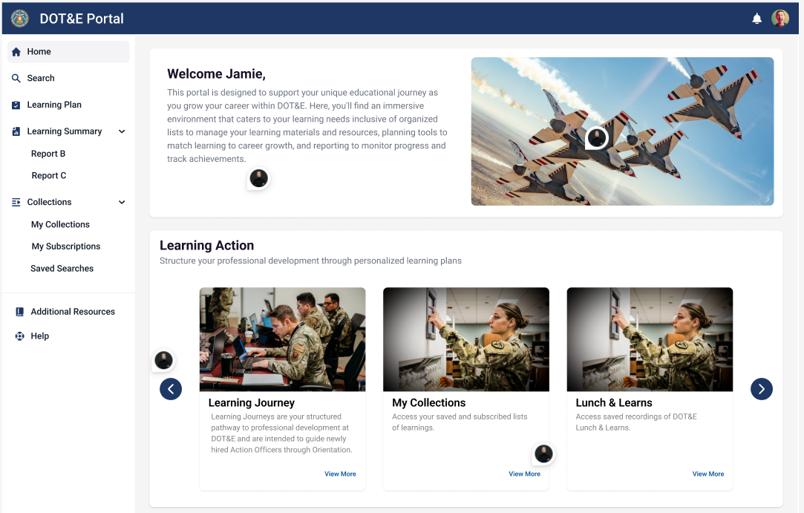
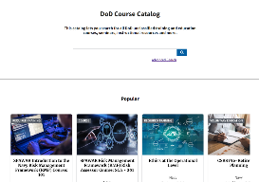
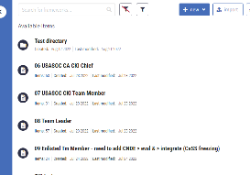
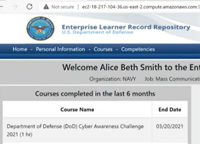
Existing EDLM Shared Applications & Services
1
2
3
4
5
Enhanced Learning Management
Extensible Content Catalog
Define the skill needed to do a DoD job
Manage Workforce Skills
Moodle LMS
Enterprise Course Catalog
Enterprise Competency and Credential Registry
Enterprise Learner Record Repository
Extensible Portal
Live in IL2 / IL4
User Authentication (E-ICAM)
Customizable Dashboards
Adaptive Learning Pathways
Seamless Integration with Moodle and other apps
Tailored to Services / End User Specifications
Live in IL2 / IL4
Deliver and manage courses
Import or build courses
Deliver certification programs
Build assessments and quizzes
View reports and analytics
Integrate with other IT
Live in IL2 / IL4
Search for DoD-wide learning & development opportunities
Link learning resources with work roles and skills
Curate lists of courses an individual is interested in.
Spotlight courses prioritized by your organization.
Live in IL2 / IL4
Select and Build skill frameworks
Define skills and/or credentials
Link skills to assessment criteria
Align skills to work roles
Crosswalk (translate) skills across services.
Live in IL4
Track workforce skill proficiencies
Track career-long training history.
Track learning that occurs inside and outside DoD
Customizable business rules & reporting
Focus Areas:
Individual Development Plans
Strategic Human Capital Planning (SHCP)
Virtual Classrooms
Multi-Tenant
Learning in the flow of work)
Discover resources inside and outside the DoD
Recommender / IDP Integration
Align with DoDI 1400.25
SHCP / TE&PD
Supports MPP / CPP and the Services
DoD-wide Data Sharing Agreements
Opt-in Sharing from Providers outside the DoD
Notes:
1 – EDLM Portal – Provides a tailorable & customizable front-end for each Service or DoD Component
2 – Moodle Learning Management System – Manage the delivery of training and education content
3 – Enterprise Course Catalog – Pulls from existing DoD-wide catalogs AND catalogs that reside outside the DoD (e.g., Coursera, EdX)
4 – Enterprise Competency & Credential Registry – Stores workforce frameworks (e.g., PDs, work roles, KSATs, Master competencies)
5 – Enterprise Learner Record Repository – Stores career-long learner records for DoD activity-duty, civilian personnel, and DoD Subcontractors
Backend services include the ECC, ECCR, and ELRR – to collect and manage training that takes place outside the LMS (e.g., modeling & simulation systems, academic institutions, commercial certifications).

Slide 9
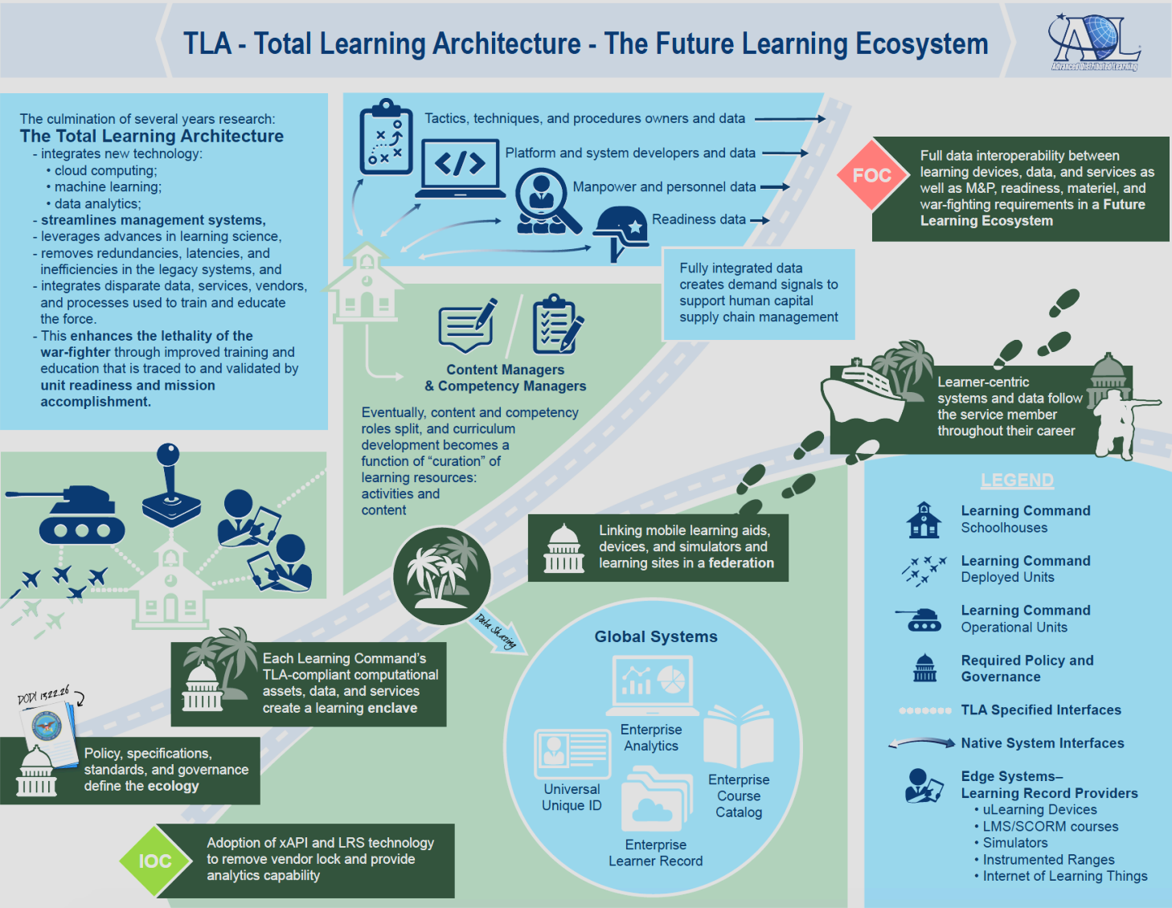
Enterprise Digital Learning Modernization (EDLM): Optimizing the DoD’s Lifecycle of Learning
EDLM DoDAF OV-1: Optimizing the DoD’s Lifecycle of Learning
EDLM Goals
Reduce total cost of ownership and streamline acquisition of common learning Tools and Technologies.
Reduce the time required for updating or acquiring instructional content.
Improve Data quality / interoperability to support AI/ML, automation, and DoD-wide decision making about human capital.
Implement data services to enable DoD-wide sharing of career-long learner data across the Services and DoD Functional Communities to improve recruiting, retention, and development of the DoD workforce.
Enhance the lethality of the warfighter through improved training and education that is traced to and validated by unit readiness and mission accomplishment
Full interoperability between learning devices, data, and services to support Manpower & Personnel, Readiness, materiel, talent management, and warfighting requirements within a Future DoD Learning Ecosystem
Transition Skills from DoD to Civilian Life, Degree Planning, Career path Planning
Schoolhouses/ institutions
Embedded training systems
Mobile
Training simulations
Professional development
Performance support / OTJ
Learning Command
Schoolhouses, MEIs, PME, Training Programs, Mandatory Training, CEUs/PDUs, Curriculum Development, ADDIE
Learning Command
Deployed Units, part task trainers, simulators, Lanes training, readiness reporting
Learning Command
Operational units, multinational exercises, mission rehearsal, after-action reviews, lessons learned
Required Policy and Governance
ADL / EDLM Specified Interfaces
Native System Interfaces
Edge Systems / Learning Record Providers
Microlearning devices
LMS courses
Simulators
Instrumented Ranges
Internet of Learning Things
Individual learning Experiences, jobs, credentials, degrees, certifications, skills external to DoD
IOC
9

Slide 10
Modern Landscape of Learning Technology Platforms
Today’s learning technology market has expanded significantly because of COVID, remote work, and continued emphasis on digital modernization (including automation, hosting, and security)
Knowledge Management
Learning Experience (LXP)
Program Delivery
Micro-Learning (Adaptive)
Assessment, Augmented &
Virtual Reality, Development Tools
Content Libraries
Digital Adoption and Workflow Learning Tools
Learning Management Systems (LMS) and Content Management
Learning Record Stores (LRS)
Notes:
Learning by Nature is Distributed.
This slide is a small snapshot of the many hundreds of different system used to delivery training and education content to employees (e.g., learners).
ADL standards was originally established to facilitate interoperability between these systems
Up until 2017 / 2018, ADL was very focused on Talent Development.

Slide 11
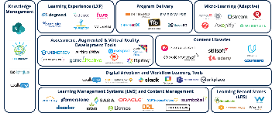
Enabling Technologies for Skill-Based Learning and Talent Management
The number of options, approaches, and technologies don’t stop here – organizations are also exploring how to create dynamic talent strategies and marketplaces to build skills and match organizational talent to the evolving needs of a business focused on change, inclusivity, and resilience: the number of platforms across product categories continues to grow.
ANTICIPATE
How work and skills will evolve
ASSESS & MEASURE
The workforce’s ability to deliver
ACTIVATE
The tools needed to hire and maintain a qualified workforce
ASSESS TECHNICAL SKILLS
ACQUISITION
LEARNING
TALENT MARKETPLACE
HRIS
MEASURE CRITICAL SKILLS
PERFORMANCE MANAGEMENT
INTERNAL MOBILITY
Notes:
The Talent Management marketplace expands the interoperability challenges between systems and data.
Compliance to standards is the only way to ensure these systems remain interoperable.

Slide 12
What is the Problem?
Data
Warehouse
Integrated Systems
Apps
Apps
Apps
Apps
SAAS
Apps
Apps
SAAS
Apps
SAAS
DB
Apps
DB
SAAS
DB
Apps
SAAS
DB
DB
DB
Apps
DB
DB
Apps
vs
Apps
SAAS
DB
SAAS
Apps
Data
Warehouse
Apps
Apps
DB
DB
DB
DB
SAAS
DB
Apps
SAAS
DB
Data
Warehouse
Data
Warehouse
DB
Apps
Apps
DB
Apps
Apps
DB
Apps
Data
Warehouse
Apps
Apps
SAAS
DoD Learning Enclave (DLE)
DB
Apps
DB
SAAS
Apps
SAAS
SAAS
DB
Apps
DB
DB
DB
HR and Talent Management need actionable data about learners to support staffing different federal jobs, work roles, occupations, and careers.
Notes:
This disparate landscape of software applications running on different IT networks managed by different organizations results in the as-is picture on the top left.
EDLM was put in place to establish the tools, standards, and technical infrastructure to enable a DoD-wide Learning Ecosystem
EDLM Data Services enable a Federated Learner Data Catalog that connects disparate systems to create a ledger of lifelong learning.

Slide 13
Enterprise Interoperability Through IEEE Standards
Competencies
(Knowledge, Skills, Abilities, and Other Behaviors required to meet operational objectives)
Brokerage Service to communicate with other Human Capital Management Systems
Learner Performance
(e.g., Learner performance, Runtime data, biometrics, outcomes)
Sharable Competency Definitions
(IEEE 1484.20.3)
Learning Experiences
(Inventory of Available Learning Opportunities, e.g., events, activities, courses, and other learning experiences)
The Experience API (xAPI)
(IEEE 9274.1)
Learner Records
(e.g., Longitudinal Records of Performance via Linkages across a Federated Data Catalog)
Standard for Learning Metadata (IEEE P2881)
Standard for Enterprise Learner Records (IEEE P2997)

Slide 14
Enterprise Interoperability Through IEEE Standards
Human Performance (IEEE 9274.1 xAPI)
Learner Records
(e.g., Longitudinal Records of Performance)
Catalog of Learning Experiences
(Inventory of Available Learning Resources and Events)
Descriptive Metadata (IEEE P2881)
Teaches / Assesses / Aligns to
Competencies
(Knowledge, Skills, Abilities, Tasks, and Other Behaviors)
Sharable Competency Definitions
(IEEE 1484.20.3)
Worldwide Learning Resources
Talent Management
(e.g., Human Resource Management, Career Field Planning, Workforce Planning)
Notes:
Data interoperability is enabled through the use of IEEE standards
Learning Resources are described and cataloged using P2881 Standard for Learning Metadata Terms
Competencies and KSATs are described using SCDs
Learner Performance is captured using xAPI
The aggregation of that data over time, supports Talent Management
Supports Individual, Self-Regulated Learning to keep employees engaged.
Promotes mobility and retention by making resources available for professional development and career progression.
Supports Career Field Management and Improved linkages to Individual Development Plans

Slide 15
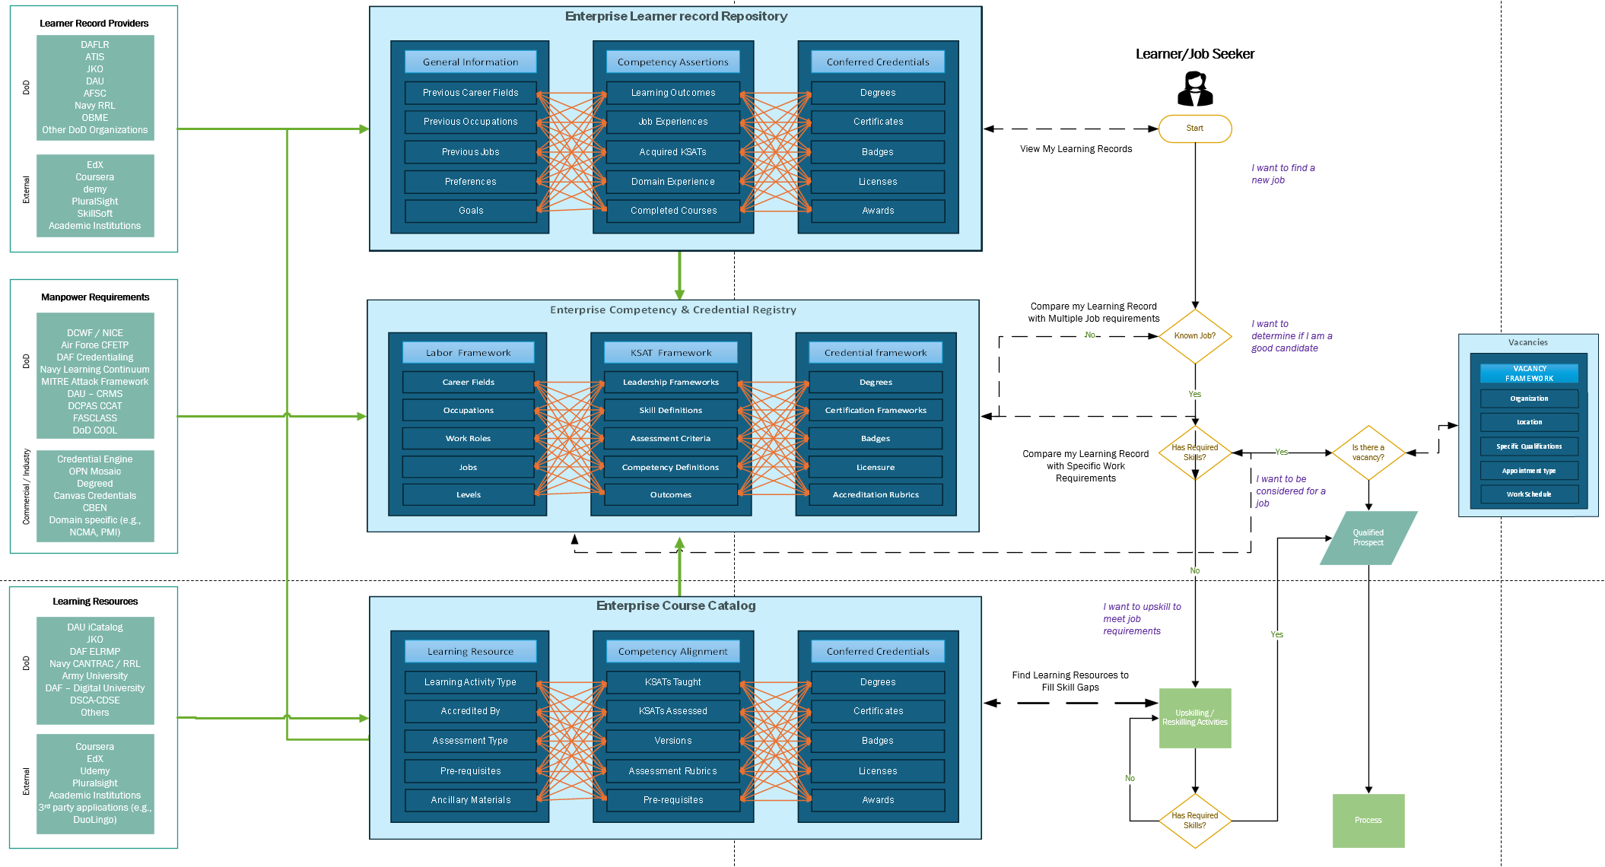
Learner / Job Seeker Journey Map
Notes:
Each of the EDLM Data Services includes a range of different information that is collected from both DoD Systems and Systems that are external to DoD.
Each of these systems works as a ‘dot-connector’ for all the data being managed by that standard.
This is one of the journey maps we’ve been building out with Sandra and Gustavo to show how a learner / job seeker might be able to use the data contained within EDLM to find new, higher paying job opportunities within the DoD.

Slide 16
EDLM Data Services: Connecting to Legacy Systems
Learner Record Consumers(Aggregate EDLM Data)
CJADC2
DCHRMS
Advana
OBME ILR
Other
Modernized Military Transcript
Talent Management
Readiness Reporting
Linked Data & Schema Server
(Rosetta Stone)
Enterprise Competency & Credential Registry
Enterprise Learner Record Repository
Enterprise Course Catalog
Glossary
4. Semantic interpretation
Automated Microservices (data scrapers)
Schemas
3. Automated Extraction, Transformation to TLA, and Loading into the EDLM Enterprise Data Services
Software used at Military Education Institution (MEIs)
Training Platforms
Digital Learning
[x]BOMs
2. Map Data to EDLM Data Standards
1. Detect Current Schema (finite number of systems in use; build mapping once, reuse)
Notes:
In a perfect world, we would have adoption at the point of delivery for all training and education content being delivered, but that’s not reality.
We know that there are millions of dollars already spent on training and education software, courses, simulations, and other content.
As courses are updated, we recommend via policy that these resources get updated to align to IEEE standards.
Until then, we built the LDSS to automatically extract, transform, and load data coming in from legacy systems – or systems that reside outside the DoD
DoD CIO just funded an additional $2.7M on this capability for FY25

Slide 17
EDLM Data Services: Connecting to Legacy Systems
Local Vocabularies
Local Vocabularies defined by different organizations, IT systems
Bi-Directional Exchange Services to Translate Local / Global Vocabularies
Allows EDLM Data Services to Map and Interpret Data from legacy systems
ELRR
EDLM / IEEE Vocabularies
LCV 1a
LCV 2a
LCV 3a
LCV 1b
LCV 2a
LCV 2b
LCV 1c
LCV 2a
LCV 2b
LCV 2b
LCV 2d
LCV 3d
definition 1a
definition 2a
definition 3a
definition 1a
definition 2b
definition 3b
definition 1c
definition 2b
definition 3c
definition 1d
definition 2d
definition 3d
CCV 1
Authoritative Def 1
ECC
CCV 2
Authoritative Def 2
CCV 3
Authoritative Def 3
CCV 4
Authoritative Def 4
CCV 5
Authoritative Def 5
ECCR
CCV 6
Authoritative Def 6
CCV 7
Authoritative Def 7
CCV 8
Authoritative Def 8
LDSS
CCV 9
Authoritative Def 9
CCV 10
Authoritative Def 10
.
.
.
CCV n
Authoritative Def n
Send
Requested Data
Example: Title
JKO = LearningResourceName
DAU = CourseName
AETC = CourseTitle
Request Data
CCV 1
CCV 4
CCV 7
API Service
Exchange Service
Send
Requested Data
CCV 1
CCV 4
CCV 7
1a
2a
3c
Send
Requested Data
Notes:
The concept is that different organizations, functional communities, or institutions will have their own set of vocabularies.
The Cyber Functional Community uses the DCWF.
NIST also has a cyber workforce framework
AirForce 17X Career Field also has a cybersecurity career field framework.
The LDSS allows each of these rubrics to be compared and linked at the atomic level.
EXAMPLE: One Service might have a job position of a COMSEC Manager while another has one called an Information Security Manager
The LDSS allows us to interpret data at the atomic level and then roll that data up to each work role → at the competency & credential level

Slide 18
Improved Data Quality / Alignment with Manpower Requirements
Person Identifiers
Contact Info
Biometrics
Other Traits
Employment Position Info
Military History
Required Skills
Occupational Category
Organizations Identifiers / Code
Organization Type
Institutional Control
Accredited By
This is how we describe RRL learning experiences
Standard for Learning Metadata
(IEEE P881)
(P2881 Profiles)
Enterprise Learner Record
(IEEE P2997)
Course
Assessment
Conference
Credentials Type / Class
Issuer / Accredited By
Effective Date
Jurisdiction
Competencies Framework URL
Proficiency Level
Competency Node ID
Status
Courses / Experiences Activity ID
Delivery Mode
Alignment
Academic Grads
Technical Format Start Date End Date Duration
Tutorial
eBook
Webinar
Video
Questions
Activity
This is how we encode work roles and functions
Disambiguation Identifier
Title
Description
Keywords
Subject Language
Offered By/Owned By
(SCD Profiles)
Institutional Competencies
Occupational Competencies
Behavioral Competencies
Credentials
(CTDL)
General Identifiers
Jurisdiction / Licensing
Publisher
Version
Competency Framework Occupational Association
Job, Duty, Position Alignment
Levels
Subject Area
Learning Teaches (Competencies)
Assesses (Competencies)
Instructional Method Education Level Instructor
Knowledge Objects
Rich Skill Descriptors
Leadership Competencies
Association Type
Source / Destination
Badges / Certifications
METLS / JMETLS
Language Competencies
HR Open
Job Data Exchange
(CTDL)
Sharable Competency Definitions (SCD)
(IEEE 1484.20.3)
Competency Definition Node Identifiers
Education Requirements
Standards / SOPs
Alignment Information
Lifecycle Management Versions
Adaptations Learning Events
Assessment Rubrics
(for different Training and Education Activities)
Career Pathways
(CTDL)
Competency Set Credentials
Hierarchical Information
Program of Instruction
Completion Criteria
Rubric (Localized) Identifier / Category
Tasks, Conditions & Standards
Performance Criteria
Weighting
Relevancy Learning Resource Type Audience Event Schedule Location Temporal Spatial Time Required
This is how we describe the KSATs for each work role
Tasks, Conditions, Standards
Training & Evaluation Outlines
Skill Matrices
ELOs / TLOs
SOPs
Performance Outcomes
Credential Transparency Description Language (CTDL)
Assessment / Evaluation Credentials / Badges
Minimum Levels of Proficiency
Demonstration Requirements
Collections Is Part Of Has Part
Performance Reviews
Direct / Indirect Assessments
Operational Outcomes

Slide 19
Operational Requirements / DoD Functional Communities
Capabilities / Skills
Jobs / Duties / Task / Conditions / Standards
Doctrine
Mission Goals / Objectives
Manpower / Experience
Performance Metrics
Enterprise Digital Learning Modernization
REQUIRES
ECCR: Workforce Competencies / Frameworks
Knowledge / Skills / Abilities
Learning Outcomes
Tasks / Conditions / Standards
Qualifications
Performance Requirements
Degrees / Certifications
Work Roles / Job Functions
Technical Skills Certifications
Behaviors / Attitudes
Assessments / Measurements
Human Resource Management
Workforce Planning
Professional Development
Career-Field Management
Talent Development / Management
Mobility / Diversity / Retention
Enabling Technology
Portal
Moodle (DOT&E developed courses housed here)
SQL LRS
TEACH
MEASURE
ECC: Training / Education Resources
Professional Military Education
Formal / Informal Learning
Self-Regulated Learning Resources
On the Job Training / Mentorships
Internships / Fellowships / Apprenticeships
ELRR: Individual Learner Records
Training and Education Experience
Operational Experience
Career Goals / Learning Goals
Learning Path / Career Path
Learning Preferences
ASSESS
Outcomes
Individual Learning Experiences
Capable Manpower
Jobs / Duties / Occupations
Leadership / Decision Making
Problem Solving / Critical Thinking
Domain Expertise / Experience
Personal / Professional Goals
Notes:
Ashley
Throughout all of these steps, we are generating information about Competencies (ECCR), learning opportunities and resources (ECC) that teach and assess these competencies, and granular information about how a learner is performing (ELRR) within and across these learning opportunities both in informal, and formal environments such as in a course, or on the job.
Through the IEEE standards, and supporting DLE capabilities (the ECCR, ECC, ELRR) we are able to gather, and synchronize these data together and deliver them to the various roles involved in the talent management pipeline in order to proactively solve for these questions and needs.

Slide 20
DoD-wide Interoperability can Benefit Force-Wide Talent Development
Talent Development
Learning Path optimization, Effectiveness, Efficiency
Enterprise Learner Record Repository
Organizational Outcomes
Automated Workflows
Improved Effectiveness
Improved Insights
Improve Efficiency of Learning Resources
Individual Outcomes
Increased learner pathway transparency
Improved insights into past experiences
Reduce Training Time
Increase Formal / Informal Opportunities
DAF Learner Data
DoN Learner Data
DAF Learner Data
Enterprise Course Catalog
Talent Management
State of the Workforce, Supply, Demand, Planning
Enterprise Competency & Credential Registry
Organizational Outcomes
Decrease Skill Gaps
Improve Mobility / Retention
Increase Talent Pool
Decrease Time to Productivity
Individual Outcomes
Increase Career-Pathway Transparency
Increase Promotion opportunities
Reduce Training duplication
Improve Performance
4th Estate Learner Data
Army Learner Data
EDLM Learner Data
Notes:
Once you’re able to interpret the DoD-wide data, you can start to make decisions to support individual and organizational outcomes.
Learning optimization can decrease the time it takes for an employee to go from novice to expert in an area
Career optimization can also look at how individuals can progress through their career more efficiently.
Organizationally, we can start to look at different jobs or careers to identify opportunities to upskill or cross train our workforce to meet evolving technological innovations.
Real time insights because of the nature of this streaming architecture.

Slide 21
Learning Journey: Artificial Intelligence
*Required proficiency level for a DOT&E Action Officer
This learning journey is designed to increase your proficiency in AI to understand AI tools, models, design, T&E protocols, and implement DoD policy for OT&E and LFT&E of AI-based and autonomous systems. This map and course offerings are updated based on the dynamic and evolving needs of Action Officers.
DRAFT
Intermediate/Proficient
Mastery
Basic/Knowledgeable
Advanced/Expertise
Understands and discusses the terminology, concepts, and principles of testing and evaluating AI systems. Can answer basic questions about AI but requires assistance to perform any tasks that require AI experience/expertise
Possesses practical experience in testing and evaluating AI systems for ethics and performance, and knowledge of human-machine teaming. You perform tasks independently with minimal guidance, understand process implications, and focus on tactical applications.
Expertise in testing and evaluating AI systems for ethics, performance, and human-machine teaming. It includes knowledge of Generative AI, functional AI, and feedback mechanisms in AI testing, ensuring compliance with DoD directives and leading multidisciplinary teams.
Mastery knowledge in testing and evaluating AI systems, real-world applications, and digital twins. Recognized as an authority, you mentor others, guide major deliverables, and focus on strategic implications and human-machine teaming. You provide guidance, foster understanding among colleagues, and ensure the integration of AI competencies with other strategic areas.
DAU: Introduction to Machine Learning
DAU: AI Foundations for the DoD Credential
Lunch & Learn: T&E of Autonomous and AI-Enabled Systems
Pursue University: Technology Innovation
Georgia Tech: AI for Business
Coursera: AI Capstone Project with Deep Learning
DAU: Overview of AI in the DoD
Harvard Kennedy School: Leading in AI: Exploring Technology & Policy
T&E of AI Guidebook
Certified Tester in Artificial Intelligence
DAU: Problem Solving for Tomorrow's Defense Leaders
Core Path
GovCIO: AI Summit Conference
UI Path Forward: Transform with AI
Purdue University:
Global Perspectives On Emerging Technologies
5000.UZ Policy Training Video
Action Officer Learning Journey
Harvard Kennedy School: Leadership in Emerging Technology: Security, Strategy & Risk
AI Expo for National Competitiveness/The Ash Carter Exchange
Coursera: CertNexus Certified Artificial Intelligence Practitioner Professional Certificate
LinkedIn Learning: Introduction to Artificial Intelligence
Carnegie Mellon University: Responsible Artificial Intelligence
C4ISR USA Conference
Basic/Knowledgeable Milestone:
Intermediate/Proficient Milestone:
Advanced/Expertise Milestone:
Mastery Milestone:
Validate your understanding of how AI/ML systems work by discussing with an AI SME
Self-initiate additional research on AI related articles, books or online resources
Shadow an AI SME colleague during OT of an AI system
Write a white paper or give a presentation on best practices for AI/ML T&E validation and verification that could assist the T&E enterprise
Identify a use case where AI can be incorporated into T&E and present it to a recognized AI expert
Observe an OT event of an AI-enabled system/autonomous system
Participate on a WIPT that conducts V&V of a trained AI/ML model
Teach the basics of developing an AI/ML model to a colleague
Review an operational test plan of an AI/ML system in order to shape test strategies and test plans
Collaborate with SIPET on AI initiatives
Give a class to colleagues on how to evaluate a TEMP for an AI/ML system
Act as the final reviewer of a report for an AI/ML system
Review DOT&E AI/ML learning opportunities and make recommendations to decision makers on areas for improvement

Slide 22
EDLM Data Services: Rationalization beyond the Platforms
HRM IT Application Rationalization (Platforms and Systems)
Competency Registries
Course Catalogs
Learner Record Stores
Learning Management
Content Rationalization
Curriculum Rationalization
Competency / Skill Frameworks
Proficiency Assessments / Certification
Dashboards and Analytics
Add Text Here
Add Text Here
This slide is 100% editable. Adjust it as per your requirements and catches your viewers consideration.
Skill Frameworks
Courses and Activities
Rich Skill Descriptors, Open Skills Network, Performance Qualifications., Industry-based Skill Standards
Courses, Microlearning, Tutorials, Webinars, eBooks, Video-based Learning, Social Learning, External DoD Resources
Competency Definitions
Performance Support
Sharable Competency Definitions, O*Net, Achievement Standards Network, CASE, Career-Field Competencies.
Just-in-Time Training, EPSS, IETMs, How-to Videos, Microlearning, Mobile Apps, Process Maps, FAQs, Discussion Threads, Reference Guides
Proficiency Models
Assessments
This slide is 100% editable. Adjust it as per your requirements and catches your viewers consideration.
Direct Assessments, Indirect Assessments, Self Assessments, Performance Reviews, Employment History
Credentials
Analytics
Certifications, Licensure, Degrees, Diplomas, Badges, .
Dashboards, Visualizations, Reporting, AI / ML, Automation Scripts, Benchmarks, Data Sharing Agreements
10
Notes:
Slide Focus: While Most folks are looking at rationalization through the lens of reducing costs for platforms and systems, ADL has found that the real opportunity is in rationalizing content & curriculum.
The EDLM Data Services allow us to start reusing content across organizations.
AETC estimates there could be as much as 70% reuse of some competency definitions across careers within a single career field in the Air Force.
Services are already finding cost savings by leveraging commercial LXPs and using existing curriculum instead of building their own.
Query Libraries allow for templates to be built to support common analytics across the Services.

Slide 23
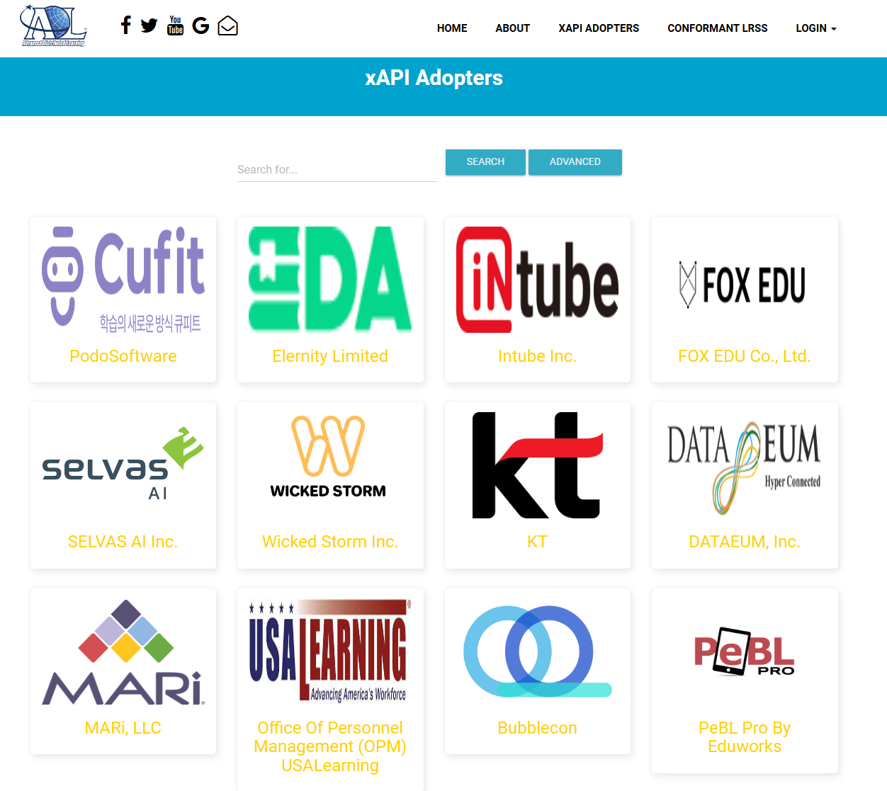
Driving adoption of ADL / EDLM Standards
DoD-Wide Adoption
Nation-wide Adoption
DHRA Implementation Plan (In Process)
Coordinating with all DHRA components to collect requirements and develop an implementation plan for connecting all DHRA components into EDLM Data Services and leveraging the DLE Moodle LMS.
Director, Operational Test & Evaluation
Leveraging EDLM to create a continuous learning platform and Talent Management Dashboards to enable an agile and enduring T&E workforce across the DoD.
Modernized Military Transcript
Working with the Defense Activity for Non-Traditional Education Support and the DoD’s Independent Voluntary Education Board (IVEB) to create a replacement for the Joint Service Transcript using EDLM data. Increases efficiency for ACE accreditation by enabling automation.
Ready Relevant Learning
RRL Interoperability Standards Working Group adopting IEEE standards and leveraging the ECC to manage RRL Performance Support capabilities in both shore-based (Cloud) and the Afloat environments (via NIAPS)
Outcome Based Military Education
Coordinating with the Office of the DASD (FE&T) to connect Military Education Institutions and Service Academies to the EDLM Infrastructure to develop an OBME Individual Learning Record
IEEE Standards included as part of Army, Navy, Air Force Acquisitions
https://adopters.adlnet.gov/adopters/0
Notes:
As of June 2020, there are 80 LMS adopters of xAPI including Moodle, Talent LMS, Survey Gizmo, Docebo, eFront, iSprint, Learn Upon, Corner Stone on Demand and Others.
DoD specific implementations are continually evolving

Slide 24
Digital Learning Services Architecture
*BG Oakland & Mr. Burse depart for one-on-one discussion
21Feb24
The overall classification of information is: UNCLASS
The overall classification of information is: UNCLASS
Notes:
DAF Learning Services slide presented at the last DADLAC meeting
DAF is following ADL standards and is implementing the data services infrastructure to connect to EDLM

Slide 25
Notes:
AETC is already building out xAPI profiles
The AETC Chief Learning Officer just established a Learning Engineering Community of Practice to start building out a more robust DAF-wide data strategy.

Slide 26
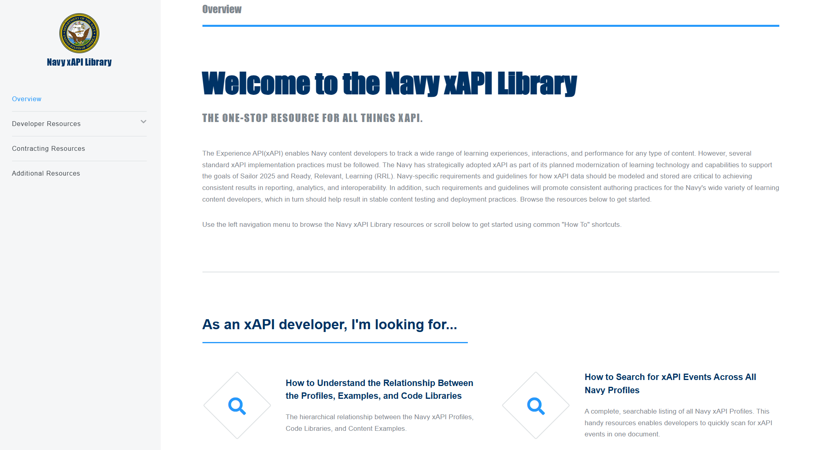
Navy Adoption
Notes:
The Navy is a leader in xAPI adoption

Slide 27
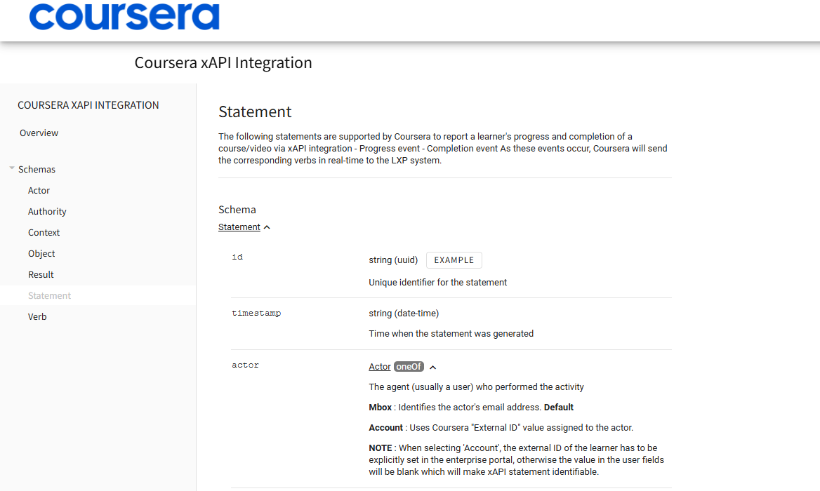
Adoption Across the L&D Community
Notes:
Even some of the organizations in this room are adopting ADL standards and specifications.
This is coursera’s implementation of xAPI – They also have a more robust business API that we want to connect with.

Slide 28
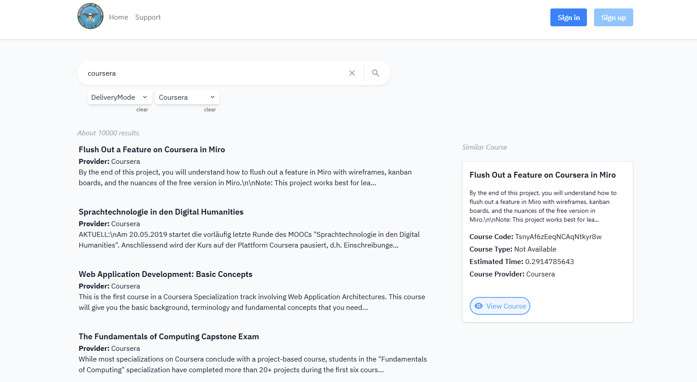
Making Connections Across the L&D Community
Notes:
ADL has already signed an NDA with Coursera and has started integrating their course catalog into the ECC
We expect to connect to the API and start increasing this integration in the near future.

Slide 29
DADLAC Talent Management Working Group
Use Cases
1. Critical Skills Determination | 2. Recruitment / Identifying Opportunities | 3. Application, Screening, and Selection | 6. Evaluation and Improvement | 7. Succession Planning
Personas
Career Field Manager | Competency Manager | Training Manager | Manager / Supervisor | Employee
1.1 Conduct Manpower Planning 2.2 Manage Recruitment Program 6.1 Develop Evaluation Measures and Tools 6.3 Performance Management 6.4 Data Analytics and Reporting 7.1 Manage Retention Processes and Procedures 7.2 Develop Succession Plan | 1.2 Create Competency Frameworks | 2.1 Create Job Solicitation 3.1 Review Applications 3.2 Candidate Assessment and Screening 6.2 Conduct Test & Evaluation 6.3 Performance Management 6.4 Data Analytics and Reporting 7.1 Manage Retention Processes and Procedures 7.2 Develop Succession Plan | 2.1 Create Job Solicitation 2.2 Manage Recruitment Program 3.2 Candidate Assessment and Screening 3.3 Candidate Selection 6.1 Develop Evaluation Measures and Tools 6.2 Conduct Test & Evaluation 6.3 Performance Management | 3.2 Candidate Assessment and Screening 6.3 Performance Management
Notes:
To make sure we’re aligned with DoD needs, we established a Talent Management Working Group under the Defense ADL Advisory Committee
Working through this group, we’ve built out user stories, personas, and a data process map for each user story.
Answering the question – What types of learner data are required to improve decision making and/or create efficiencies throughout the Talent Management Lifecycle.

Slide 30
Upcoming Opportunities
EDLM Operations & Sustainment
Maintain EDLM’s SDLC
Container Maintenance (Iron Bank)
CI/CD Pipeline Maintenance
Help Desk
Tier 0, 1, 2
Conus / Oconus
Learning Services & Curriculum Development
ADDIE Services
Blended Curriculum / Content Development
Compliance Testing with ADL Standards (xAPI, P2881, SCDs)

Slide 31
ADL Designated a DoD Pathfinder for Enterprise Data Services
The ADL enterprise architecture is highly aligned to the principles and goals of the DoD Data Strategy and consistent with our vision for a Defense-wide data ecosystem. While focused on training and education, the ADL program is modeling a number of best practices in their development of standards, business processes, and enterprise services.
ADL has created a mature, integrated development environment…
I am pleased to designate ADL as a pathfinder for
enterprise data services.
Dave Spirk,
DoD Chief Data Officer
08 June 2021

Slide 32
Agile Practices
Collaborative Project Mgmt.
Version Control
Audit, Logging, Telemetry
Automated Testing
GitLab Runners
Kubernetes Container Orchestration
ArgoCD Kubernetes Management
Application Refactoring
Operations & Sustainment
Iron Bank Container Hardening
Cloud Native Access Point
Keycloak
ICAM / Zero Trust Architecture
Istio Endpoint Management
Enables an IL2/4 Continuous Authority to Operate (IL5 in the Future)

Slide 33
Moodle Open Source
https://moodle.org/

Slide 34
What is Moodle?
Open Source LMS with a robust developer community – Tools continuously improved
Customizable: Plug ins and Themes extend baseline functionality
Group Management Tools: Rooted in Constructivist Pedagogy which emphasizes interaction between students and the use of student-generated content as a learning resource
Ability to generate a ‘story’ of each student’s course experience, which contains completed activities along with postings, assignment results, and other statistics.
Compatible with a wide range of commercial tools and services
Rudimentary support of xAPI right out of the box.

Slide 35
DLE Moodle Value Proposition
Continuous Updates / Shared IT Services for hosting, operating, maintaining
Certification Workflows
Cmi5 Plugin
Allows delivery of non-browser-based activities (e.g., AR/VR, Serious Games, Mobile, in-person assessments)
Increased granularity of learner performance data from Moodle activities
Cmi5 is built around xAPI and is natively compatible with EDLM Data Services
Moodle data synchronized with EDLM data services
Courses published to the Enterprise Course Catalog
Courses and Learning Activities aligned to competencies and credentials in the Enterprise Competency and Credential Registry.
Integrated with SQL LRS or Veracity LRS (with additional work)
Moodle Support
Moodle Service Desk e and a robust knowledge base enables users to resolve issues themselves

Slide 36
Continuous Learning Platform
Moodle is comprised of an interconnected system of systems that deliver independent learning resources, formal courses, and other learning experiences
Courses
Wikis
Forums
Glossaries
Quizzes
Assessments
Assignments
Videos
H5P
Surveys
Discussions
Knowledge Checks
Group Activities
Dashboards
Task Trackers
Online Courses
Serious Games
LVC Simulations
AR / VR applications
Guided Practices
Mobile Applications
Quizzes
Demonstrations
Asynchronous Activities
Cmi5 Plugin
Validates xAPI Statements
Highly Structured Data
xAPI 2.0 Conformant
Compatible with SQL-based BI Tools
Data accessible via browser-based UI or API Calls
Flexible Business Rules for Data Routing
Virtual Classroom
Web Conferencing
VILT
Webinars
Live Lectures
Demonstrations
Virtual Office Hours
Chat
Screen Share
White Boards
Breakout Rooms
Notes
Shared documents
Numerous Learning Activities are sequenced together to build online courses

Slide 37
Reimagined Curriculum to Support Continuous Learning
Simulator
Systems
Multinational
Exercises
k
https://www.harvardbusiness.org/insight/how-the-workforce-learns-in-2019/
Harvard Business Publishing / Degreed (2019)
People Learn inside and Outside the Flow of Work
Notes:
Informed by ‘How the Workforce Learns in 2019’ publication by degreed and Harvard Business Publishing.

Slide 38
Value Proposition for the Moodle LMS
Value | Description | Implication
Open-source | Large and active developer community – leverage investments LMSs are a commodity – Moodle includes standard LMS capabilities Extensibility to meet evolving DoD requirements | Reduces costs across the Software Development Lifecycle
Data Quality | Improved insights into learner performance Ability to collect data from online / offline resources Integrated with EDLM data services (ECC, ECCR, ELRR) | More meaningful data: Enable continuous improvements across the lifecycle of learning
Modality | Blended learning and connectivity with simulations and exercises Containerized to support offline deployments (e.g., Navy Afloat) | Interoperability: Connect and manage all digital learning activities (e.g., simulations, exercises)
Security | Layered security architecture under the P1 continuous ATO Certificate to Field for IL2 and IL4 (IL5 Capable) Continuous Monitoring by C5ISR (under P1) | Software Modernization: Build once / Deploy often and enable shared services
Customizability | Custom themes, plugins, page layouts Tailored UI/UX and workflows to meet different organizational requirements Tailor organizational roles / permissions | Increase Adoption: Tailorable front end to meet Service-specific requirements
Moodle currently used by Army, Navy, Air Force, and other Government Agencies
Open Source – New Capabilities Continuously Developed
ADL Operates Moodle Software as a Service
Other or Additional LMSs can be added if needed
80M users 48.5M courses 155K sites 240 countries
Notes:
LMSs are a commodity software product
Moodle is open-source so DoD customizations can be made easily
Allows DoD to benefit from other investments into the LMS
Some of the things that make this LMS better than its competitors are
Depth of data captured: Other systems only capture whether a student has finished a course. But the details about where learners struggle, which parts of the course are too easy or too hard, which parts are revisited, and which parts of the assignments a learner is better at matter immensely.
The ADL Moodle instance is supported with xAPI and profiles, which means our system captures all these details for use in building future training and managing your workforce.
Modality: Other LMSs can’t support anything but slides and videos displayed in a browser. ADL Moodle is designed to support virtual classrooms (BBB, active in 4 mo), complex environments including XR training, simulator connections, and live environments.
ADL’s Moodle does this b/c it’s equipped with cmi5 instead of SCORM.
Security: ADL’s Moodle is in compliance with Defense Business System requirements, and has a continuous ATO tied to Platform 1. Not all systems have this.
This means our system meets security requirements needed to support operation at scale.
Customizability: the ADL Moodle instance supports the kinds of customizability that are going to be needed by an enterprise-level user population.
Our instance of Moodle is exclusively open source, and matches the most widely distributed design in the world (80M users with 48.5M courses in 240 countries). Except we improved on it.

Slide 39
EDLM LMS Shared Services Roadmap
Moodle LMS
OpenLXP
(Course Catalog)
Competency and Credential Registry
Learner Record System
SQL LRS
Data Services
Training Services
L&D Support Services
Course Builder / Quiz Builder
User Lists / Interests
Search and Discovery
Individual / Team Learner Profiles
xAPI Validation
Data Strategy Development
LMS / Courseware Migration
Knowledge Management
Integration with 3rd party tools
Search and Discovery
Competency Creation Tools
Learner API
Data Management / Routing
Standard Profiles
Job / Task Analysis
Performance Support Tools
Custom Theme / Branding
Automated Content Curation
Import / Export
Data Services
Learner Record Aggregation
Integrations with 3rd Party BI Tools
Learner Data Migration
Instructional Systems Design
Assessment Design and Delivery
Cmi5 / xAPI Integration
Competency / Skill Mapping
Relationship Mapping
Automated Extraction Service
Reactions / Triggers
Privacy and Security
Content / Course Development
Testing Services
Dashboards / Analytics
3rd Party Catalog Integrations
Comparative Analysis Tools
Dashboards / Analytics
Cross platform Integration
Decision Support Tools
Serious Games / Simulations
Engagement Analysis
Plugin Library
Instructor Support Tools
Competency & Credential Library
Workforce Analysis Tools
Dashboard / Query Templates
Records Management
Instructor Support Services
Mentoring / Coaching
Support Desk
Career / Degree Planning Tools
Workforce Frameworks
Workforce Planning Tools
Reporting Tools
Policy Based Access Control
Translation / Accessibility
Workforce Skill Gap Analysis
Virtual Classrooms
Mobile Learning
Recommender Services
Strategic Human Capital Planning
Self Assertions / External Records
Synchronization Services
Automation
Pilots / Testing
Needs Assessments
Multi Tenant
IDPs / Optimized Learning Paths
Assessment Rubrics Library
3rd party Integrations
Legend
IL5 / IL6 / High-side
Learning in the Flow of work
Curriculum Rationalization
3rd party Integrations
Learner Wallets
Available Today
Roadmap
Notes:
NOTE: Not all systems listed are Learning Management Systems. Many of these applications are designed for other purposes but include training and education components that can be offset by using DLE systems at a lower price than what they are currently paying.
Assumption: If we average out at $500K savings per system / capability, we can save $64M in IT/Cyber/Software Maintenance costs DoD-wide – This is a conservative estimate.

